Slide 1


Noida Institute of Engineering and Technology, Greater Noida
Statistics and Probability
Unit: 3
Probability distribution
AAS0303
Dr. Anil Agarwal
Associate Professor
Dept. of Mathematics
AIML- IIIrd Sem
AIML Unit-3

Slide 2
Content(CO-3)
Introduction of Probability distributions
Binomial Distribution
Poisson Distribution
Normal Distribution
Exponential Distribution
AIML Unit-3

Slide 3
Course Objective
Understand the different basic concept / fundamentals of business statistics.
2. Understand the practical application of various concepts.
3. Understand the importance of measures of Descriptive statistics which includes measures of central tendency, Measures of Dispersion, Time Series Analysis, Index Number, Correlation and Regression analysis and their implication on Business performance.
4. Understand the concept of Probability and its usage in various business applications.
5. Understanding Decision making environment and applying the Concept of Business Analytics.
AIML Unit-3

Slide 4
Unit Objective of Probability Distributions (CO-3)
A basic knowledge in probability theory.
The student is able to reflect developed mathematical methods in probability and statistics.
Understand the concept of Probability and its usage in various business applications.
The binomial distribution model allows us to compute the probability of observing a specified number of "successes" when the process is repeated a specific number of times
Poisson Distribution is a tool that helps to predict the probability of certain events from happening when you know how often the event has occurred.
To learn the characteristics of a typical normal curve.
7. To explore the key properties, such as the moment-generating function, mean and variance, of a normal random variable.
AIML Unit-3

Slide 5
Course Outcome
CO1. Gaining Knowledge of basic concept / fundamentals of statistics and various Descriptive measures i.e. Central tendency of data, Moments, Skewness, Kurtosis, Co-relation, regression, Time Series analysis etc.
CO2. The course provides the knowledge of Probability theory and random variable etc.
CO3. The course enables the students to understand the Various distributions like Binomial distribution, Poisson distribution, Normal distribution and Exponential distribution.
CO4. Evaluating basic concepts of Population & Sampling, Test of Hypothesis, Statistical Inference, Parameter estimation, Maximum likelihood estimation etc.
CO5. The course provide the knowledge of Mathematics Aptitude like solving the Pipe & Cistern, Boat & Stream, Speed, distance & time, Sitting arrangements, Clock & calendar etc.
AIML Unit-3

Slide 6
PO
S.No | Program Outcomes (POs)
PO 1 | Engineering Knowledge
PO 2 | Problem Analysis
PO 3 | Design/Development of Solutions
PO 4 | Conduct Investigations of Complex Problems
PO 5 | Modern Tool Usage
PO 6 | The Engineer & Society
PO 7 | Environment and Sustainability
PO 8 | Ethics
PO 9 | Individual & Team Work
PO 10 | Communication
PO 11 | Project Management & Finance
PO 12 | Lifelong Learning
AIML Unit-3

Slide 7
PSO
PSO | Program Specific Outcomes (PSOs)
PSO 1 | To apply knowledge of basic sciences and biotechnological techniques
PSO 2 | To design, optimize, analyze & scale up bioprocesses to develop useful products with societal consideration
PSO 3 | To generate, analyze & interpret biological data using insilico & other relevant approaches.
AIML Unit-3

Slide 8
CO-PO and PSO Mapping
Sr. No | Course Outcome | PO1 | PO2 | PO3 | PO4 | PO5 | PO6 | PO7 | PO8 | PO9 | PO10 | PO11 | PO12
1 | CO 1 |  |  |  |  | H |  |  |  |  |  |  | M
2 | CO 2 |  | M | M |  |  |  | M |  | H
3 | CO 3 |  | H | H |  |  |  |  | M |  | H
4 | CO 4 |  | M | H | M |  | H
5 | CO 5 |  | H | H |  | H |  |  |  |  | M |  | M
*H= High *M= Medium
Program Specific Outcomes | Course Outcomes
 | 1 | 2 | 3 | 4 | 5
1 | M | H | H | H | H
2 | M | M | H | H | H
3 | - | - | - | - | -
*H= High *M= Medium
AIML Unit-3

Slide 9
Topic Objective of Probability Distributions(CO-3)
The probability distributions are very much helpful for making predictions. Estimates and predictions form an important part of research investigation. With the help of Probability distributions, we make estimates and predictions for the further analysis.
AIML Unit-3

Slide 10
Prerequisite and Recap
Knowledge of combination
Knowledge of permutation
Some basic concepts of set theory.
Probability Theory
AIML Unit-3

Slide 11
Probability distributions(CO-3)
Theoretical probability distribution
Discrete probability distributions
Continuous probability distributions
Binomial Distribution
Poisson Distribution
Normal Distribution
t- Distribution
F-Distribution
AIML Unit-3

Slide 12
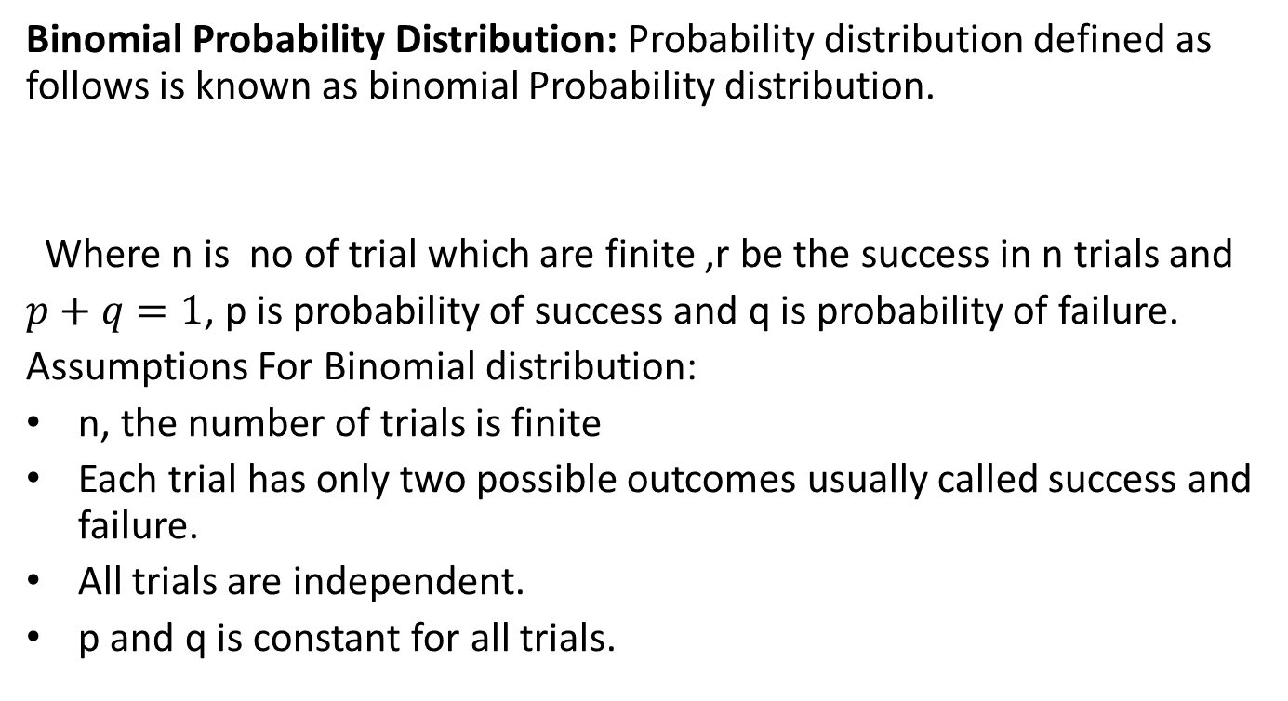

Binomial Distribution(CO-3)
Binomial Probability Distribution: Probability distribution defined as follows is known as binomial Probability distribution.
Where n is no of trial which are finite ,r be the success in n trials and
$p+q=1$, p is probability of success and q is probability of failure.
Assumptions For Binomial distribution:
n, the number of trials is finite
Each trial has only two possible outcomes usually called success and failure.
All trials are independent.
p and q is constant for all trials.
$P\left(X=r\right)={{}_{}^{n}C}_{r}p^{r}q^{n−r}$,$r=1,2…n$
AIML Unit-3

Slide 13
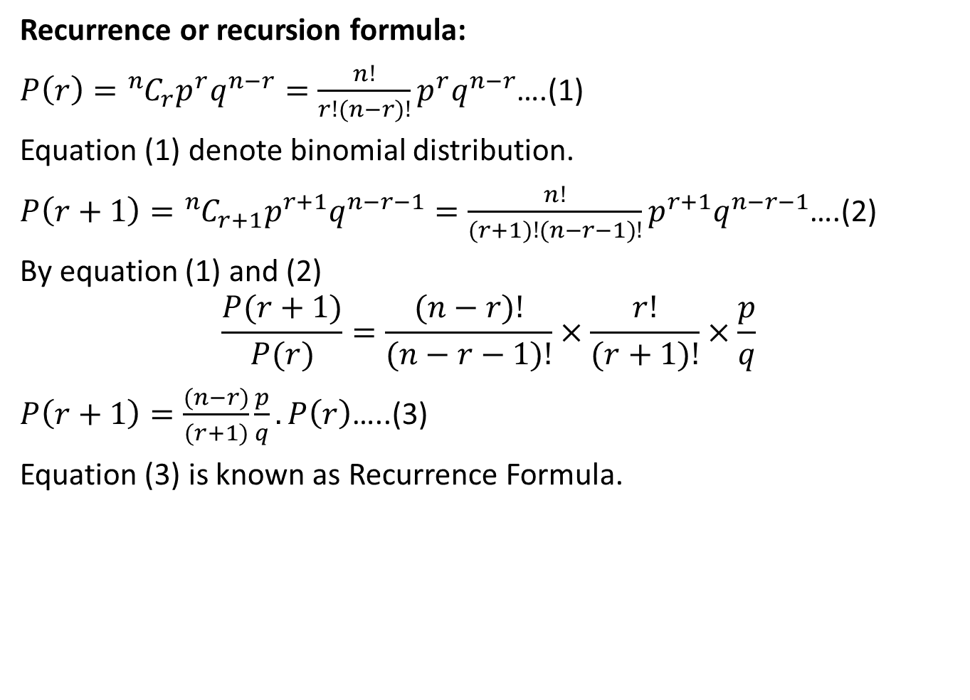
Cont…(CO-3)
Recurrence or recursion formula:
$P\left(r\right)={{}_{}^{n}C}_{r}p^{r}q^{n−r}=\frac{n!}{r!(n−r)!}p^{r}q^{n−r}$….(1)
Equation (1) denote binomial distribution.
$P\left(r+1\right)={{}_{}^{n}C}_{r+1}p^{r+1}q^{n−r−1}=\frac{n!}{(r+1)!(n−r−1)!}p^{r+1}q^{n−r−1}$….(2)
By equation (1) and (2)
$$\frac{P(r+1)}{P(r)}=\frac{(n−r)!}{(n−r−1)!}×\frac{r!}{(r+1)!}×\frac{p}{q}$$
$P\left(r+1\right)=\frac{(n−r)}{(r+1)}\frac{p}{q}. P\left(r\right)$…..(3)
Equation (3) is known as Recurrence Formula.
AIML Unit-3

Slide 14
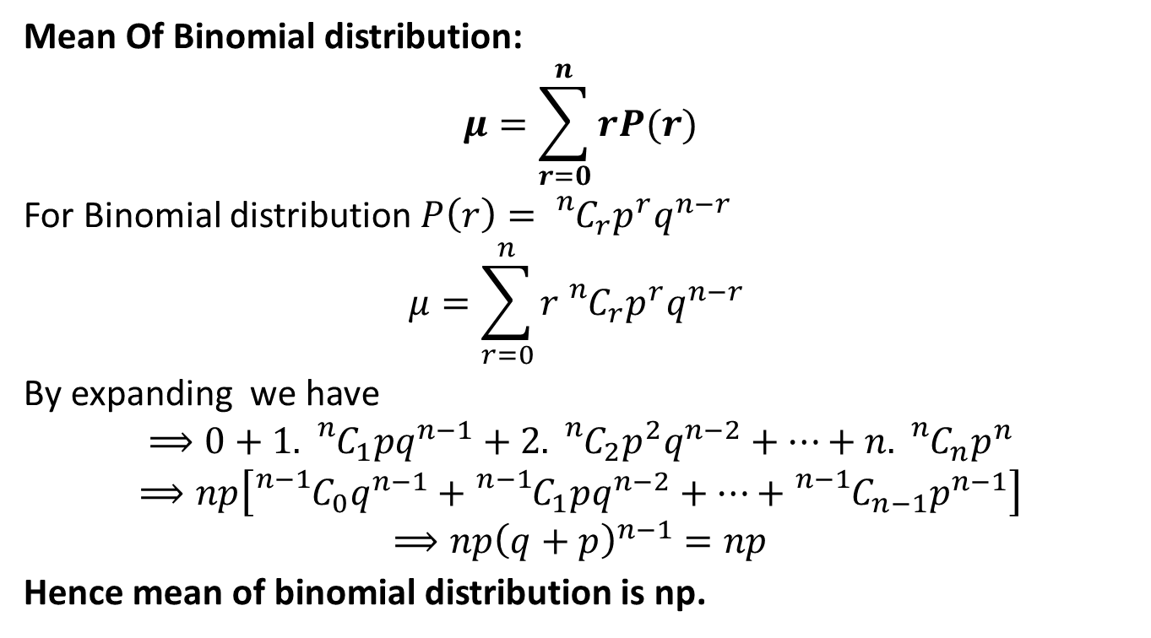
Cont…(CO-3)
Mean Of Binomial distribution:
$$μ=\sum_{r=0}^{n}{rP(r)}$$
For Binomial distribution $P\left(r\right)={{}_{}^{n}C}_{r}p^{r}q^{n−r}$
$$μ=\sum_{r=0}^{n}{r{{}_{}^{n}C}_{r}p^{r}q^{n−r} }$$
By expanding we have
$$⟹0+1.{{}_{}^{n}C}_{1}pq^{n−1}+2.{{}_{}^{n}C}_{2}p^{2}q^{n−2}+…+n.{{}_{}^{n}C}_{n}p^{n}$$
$$⟹np\left[{{}_{}^{n−1}C}_{0}q^{n−1}+{{}_{}^{n−1}C}_{1}pq^{n−2}+…+{{}_{}^{n−1}C}_{n−1}p^{n−1}\right]$$
$$⟹np{\left(q+p\right)}^{n−1}=np$$
Hence mean of binomial distribution is np.
AIML Unit-3

Slide 15
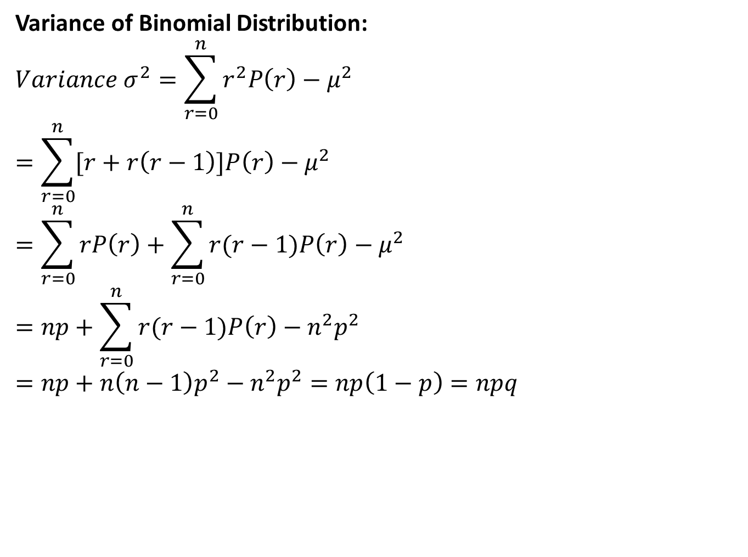
Cont…(CO-3)
Variance of Binomial Distribution:
$$Variance σ^{2}=\sum_{r=0}^{n}{r^{2}P\left(r\right)−μ^{2}}$$
$$=\sum_{r=0}^{n}{[r+r\left(r−1\right)]P\left(r\right)−μ^{2}}$$
$$=\sum_{r=0}^{n}{rP\left(r\right)+\sum_{r=0}^{n}{r(r−1)P\left(r\right)−μ^{2}}}$$
$$=np+\sum_{r=0}^{n}{r(r−1)P\left(r\right)−n^{2}p^{2}}$$
$$=np+n\left(n−1\right)p^{2}−n^{2}p^{2}=np\left(1−p\right)=npq$$
AIML Unit-3

Slide 16
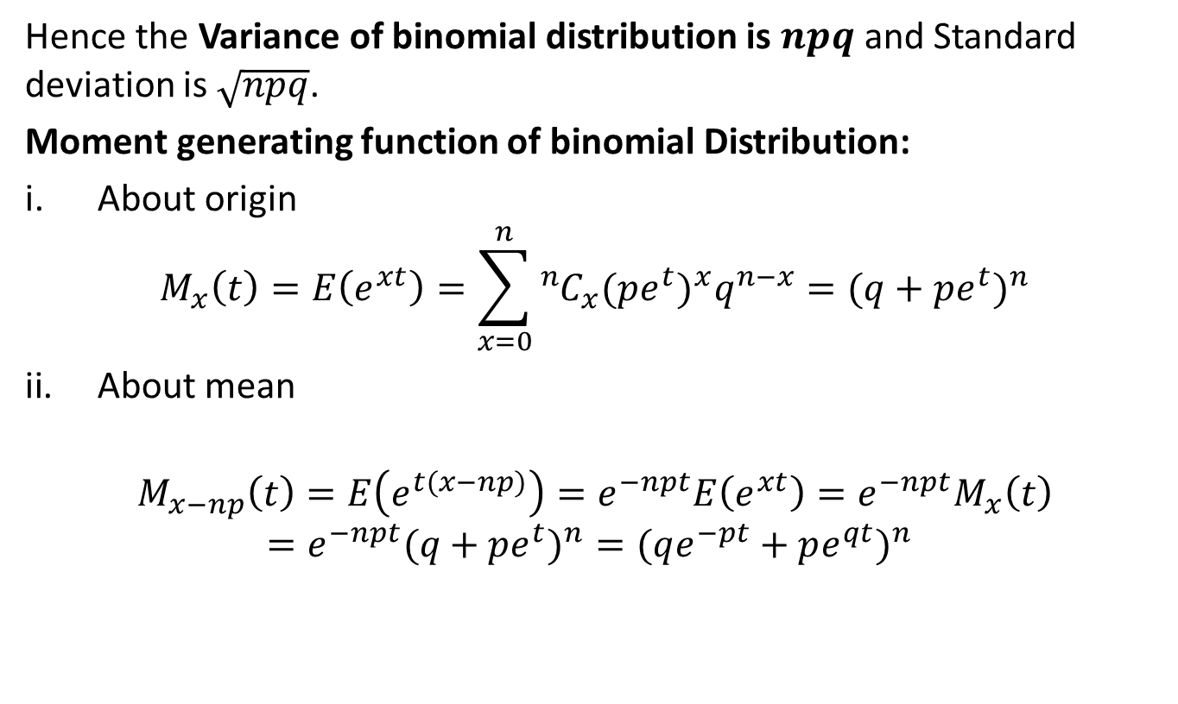
Cont…(CO-3)
Hence the Variance of binomial distribution is $npq$and Standard deviation is $\sqrt{npq}$.
Moment generating function of binomial Distribution:
About origin
$$M_{x}\left(t\right)=E\left(e^{xt}\right)=\sum_{x=0}^{n}{{{}_{}^{n}C}_{x}({pe^{t})}^{x}q^{n−x}}={(q+pe^{t})}^{n}$$
About mean
$$M_{x−np}\left(t\right)=E\left(e^{t(x−np)}\right)=e^{−npt}E\left(e^{xt}\right)=e^{−npt}M_{x}\left(t\right)={e^{−npt}(q+pe^{t})}^{n}={(qe^{−pt}+pe^{qt})}^{n}$$
AIML Unit-3

Slide 17
Cont…(CO-3)
Applications of Binomial Distribution:
In problem concerning no. of defectives in sample production line.
In estimation of reliability of systems.
No. of rounds fired from a gun hitting a target.
In radar detection.
Q1. If 10% of bolts are produced by a machine are defective , determine the probability that out of 10 bolts chosen at random
1
None
At most 2 bolts will be defective
AIML Unit-3

Slide 18
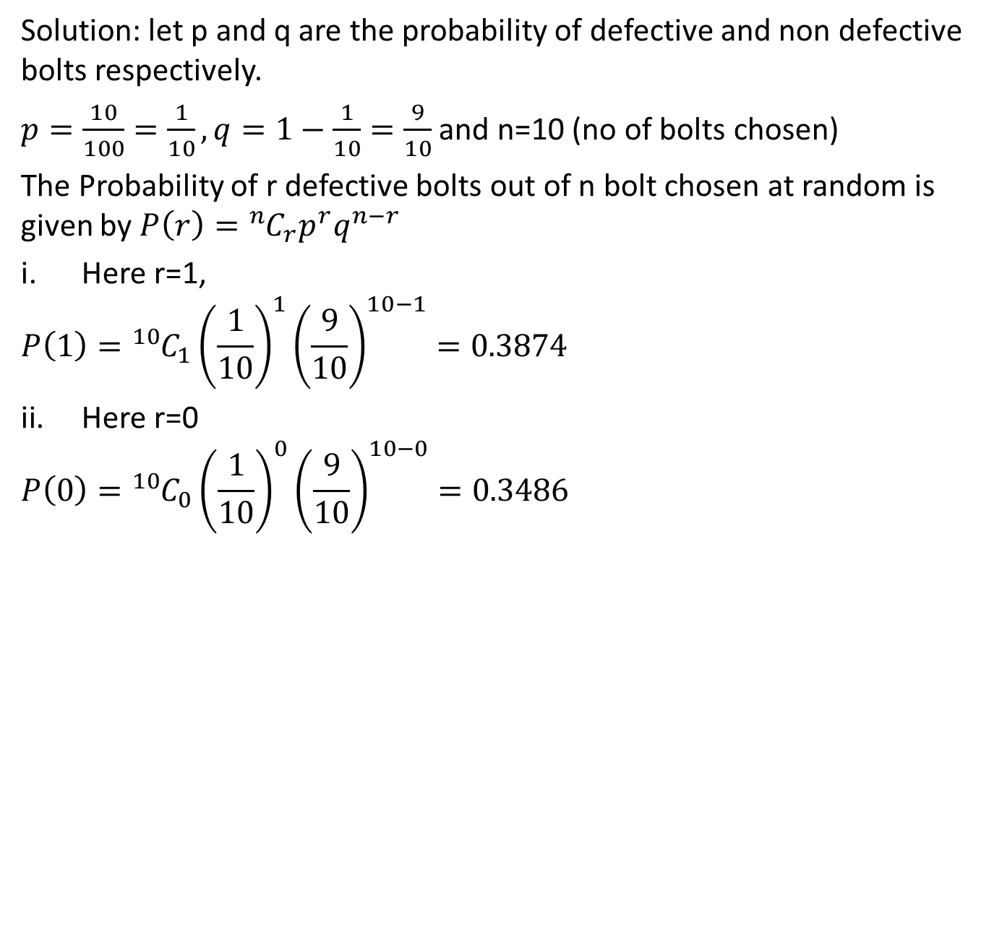
Problem’s based on Binomial
Distribution(CO-3)
Solution: let p and q are the probability of defective and non defective bolts respectively.
$p=\frac{10}{100}=\frac{1}{10},q=1−\frac{1}{10}=\frac{9}{10}$ and n=10 (no of bolts chosen)
The Probability of r defective bolts out of n bolt chosen at random is given by $P\left(r\right)={{}_{}^{n}C}_{r}p^{r}q^{n−r}$
Here r=1,
$$P\left(1\right)={{}_{}^{10}C}_{1}{\left(\frac{1}{10}\right)}^{1}{\left(\frac{9}{10}\right)}^{10−1}=0.3874$$
Here r=0
$$P\left(0\right)={{}_{}^{10}C}_{0}{\left(\frac{1}{10}\right)}^{0}{\left(\frac{9}{10}\right)}^{10−0}=0.3486$$
AIML Unit-3

Slide 19
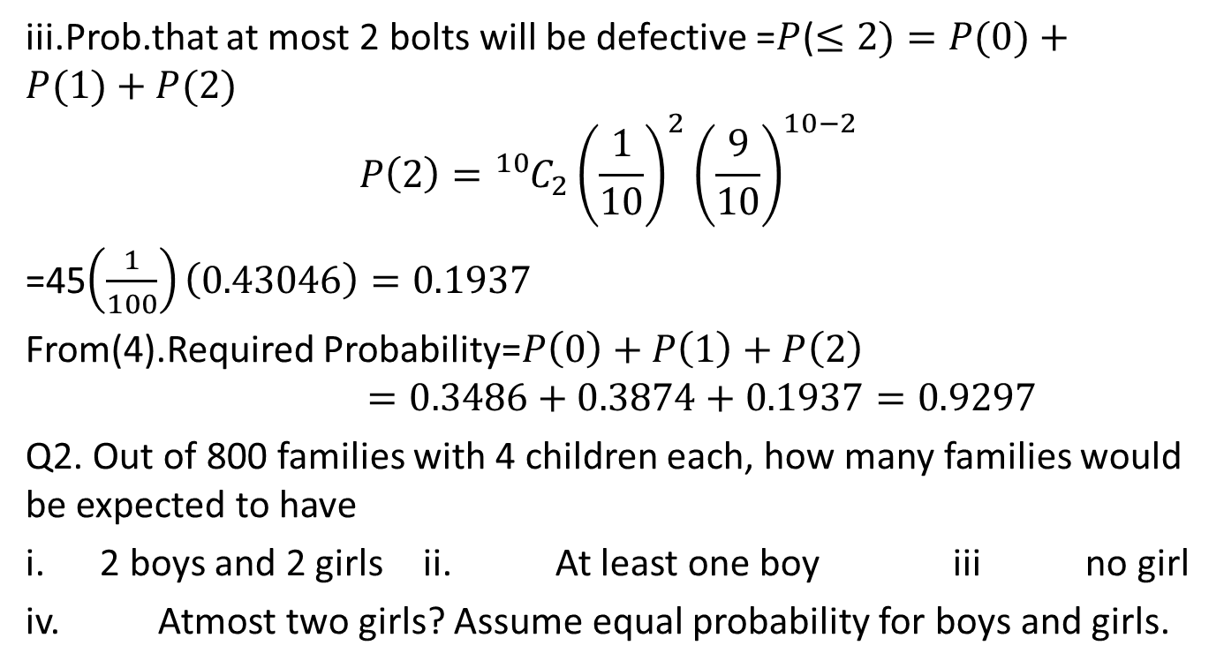
Problem’s based on Binomial
distribution(CO-3)
iii.Prob.that at most 2 bolts will be defective =$P$($≤2)=P(0)+P(1)+P(2)$
$$P\left(2\right)={{}_{}^{10}C}_{2}{\left(\frac{1}{10}\right)}^{2}{\left(\frac{9}{10}\right)}^{10−2}$$
=45$\left(\frac{1}{100}\right)\left(0.43046\right)=0.1937$
From(4).Required Probability=$P\left(0\right)+P\left(1\right)+P\left(2\right)$
$$=0.3486+0.3874+0.1937=0.9297$$
Q2. Out of 800 families with 4 children each, how many families would be expected to have
2 boys and 2 girls ii. At least one boy iii no girl
iv. Atmost two girls? Assume equal probability for boys and girls.
AIML Unit-3

Slide 20
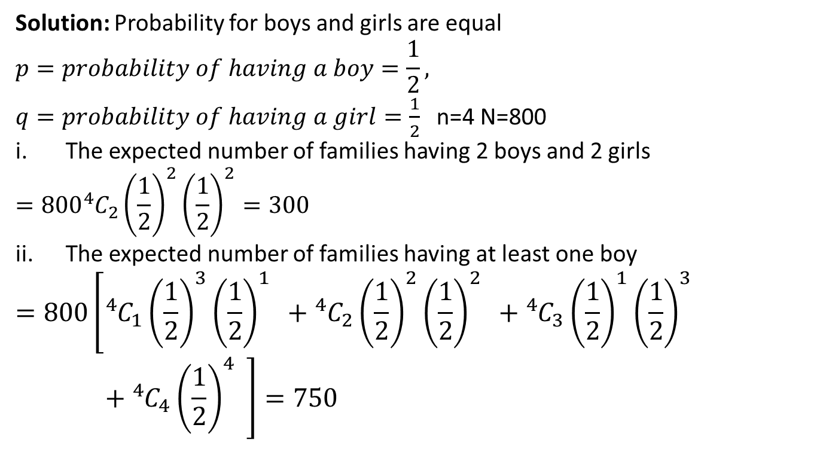
Cont…(CO-3)
Solution: Probability for boys and girls are equal
$$p=probability of having a boy=\frac{1}{2},$$
$q=probability of having a girl=\frac{1}{2}$ n=4 N=800
The expected number of families having 2 boys and 2 girls
$$=800{}_{}^{4}{C_{2}{\left(\frac{1}{2}\right)}^{2}{\left(\frac{1}{2}\right)}^{2}=300}$$
The expected number of families having at least one boy
$$=800\left[{}_{}^{4}{C_{1}{\left(\frac{1}{2}\right)}^{3}{\left(\frac{1}{2}\right)}^{1}} +{}_{}^{4}{C_{2}{\left(\frac{1}{2}\right)}^{2}{\left(\frac{1}{2}\right)}^{2}} +{}_{}^{4}{C_{3}{\left(\frac{1}{2}\right)}^{1}{\left(\frac{1}{2}\right)}^{3}} +{}_{}^{4}{C_{4}{\left(\frac{1}{2}\right)}^{4}} \right]=750$$
AIML Unit-3

Slide 21
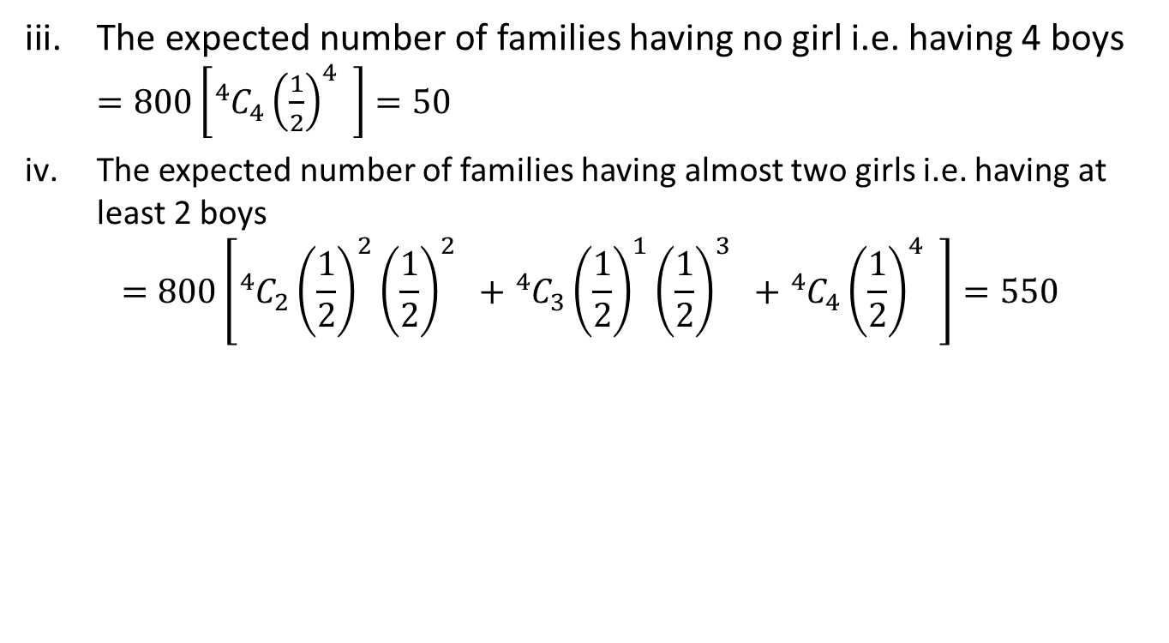
Cont…(CO-3)
The expected number of families having no girl i.e. having 4 boys $=800\left[{}_{}^{4}{C_{4}{\left(\frac{1}{2}\right)}^{4}} \right]=50$
The expected number of families having almost two girls i.e. having at least 2 boys
$$=800\left[{}_{}^{4}{C_{2}{\left(\frac{1}{2}\right)}^{2}{\left(\frac{1}{2}\right)}^{2}} +{}_{}^{4}{C_{3}{\left(\frac{1}{2}\right)}^{1}{\left(\frac{1}{2}\right)}^{3}} +{}_{}^{4}{C_{4}{\left(\frac{1}{2}\right)}^{4}} \right]=550$$
AIML Unit-3

Slide 22
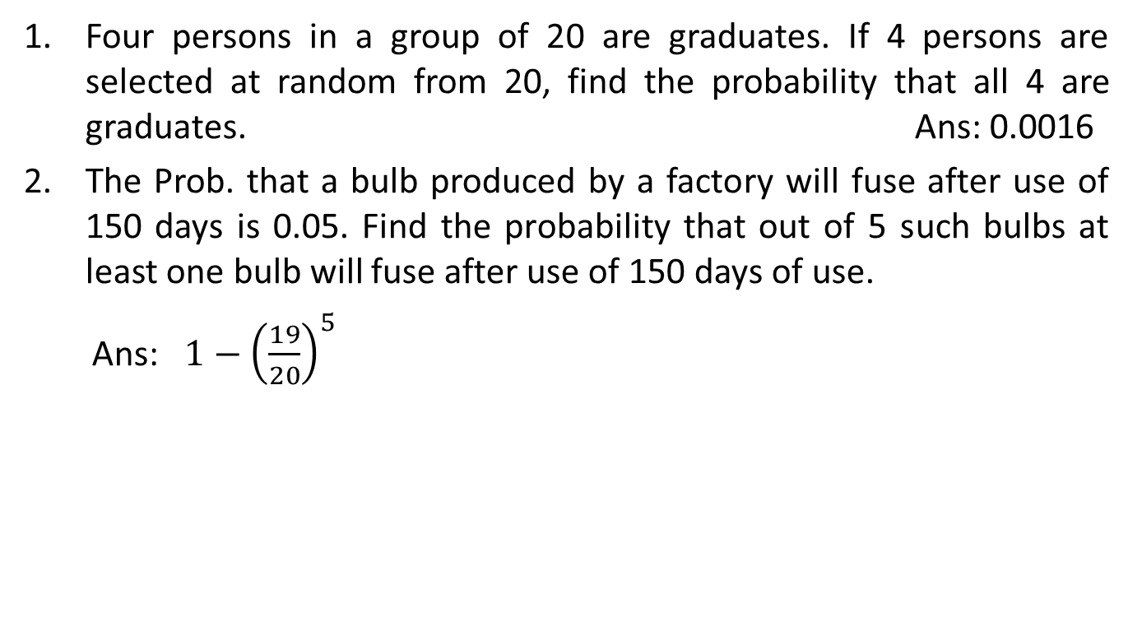
Daily Quiz(CO-3)
Four persons in a group of 20 are graduates. If 4 persons are selected at random from 20, find the probability that all 4 are graduates. Ans: 0.0016
The Prob. that a bulb produced by a factory will fuse after use of 150 days is 0.05. Find the probability that out of 5 such bulbs at least one bulb will fuse after use of 150 days of use.
Ans: $1−{\left(\frac{19}{20}\right)}^{5}$
AIML Unit-3

Slide 23
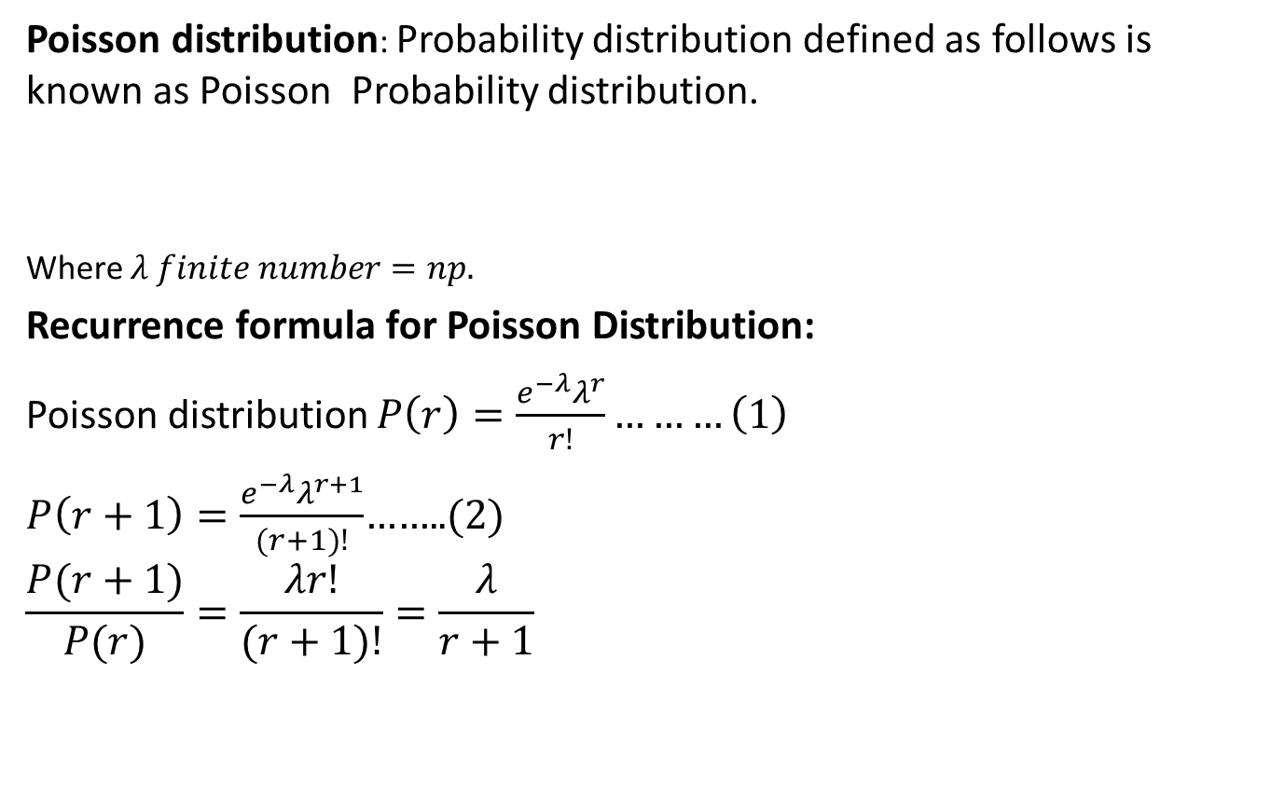

Poisson Distribution(CO-3)
Poisson distribution: Probability distribution defined as follows is known as Poisson Probability distribution.
Where $λ finite number=np.$
Recurrence formula for Poisson Distribution:
Poisson distribution$P\left(r\right)=\frac{e^{−λ}λ^{r}}{r!}………\left(1\right)$
$P\left(r+1\right)=\frac{e^{−λ}λ^{r+1}}{(r+1)!}$……..(2)
$$\frac{P(r+1)}{P(r)}=\frac{λr!}{(r+1)!}=\frac{λ}{r+1}$$
$$P\left(X=r\right)=\frac{e^{−λ}λ^{r}}{r!}, \left(r=0,1,2,3….\right)$$
AIML Unit-3

Slide 24
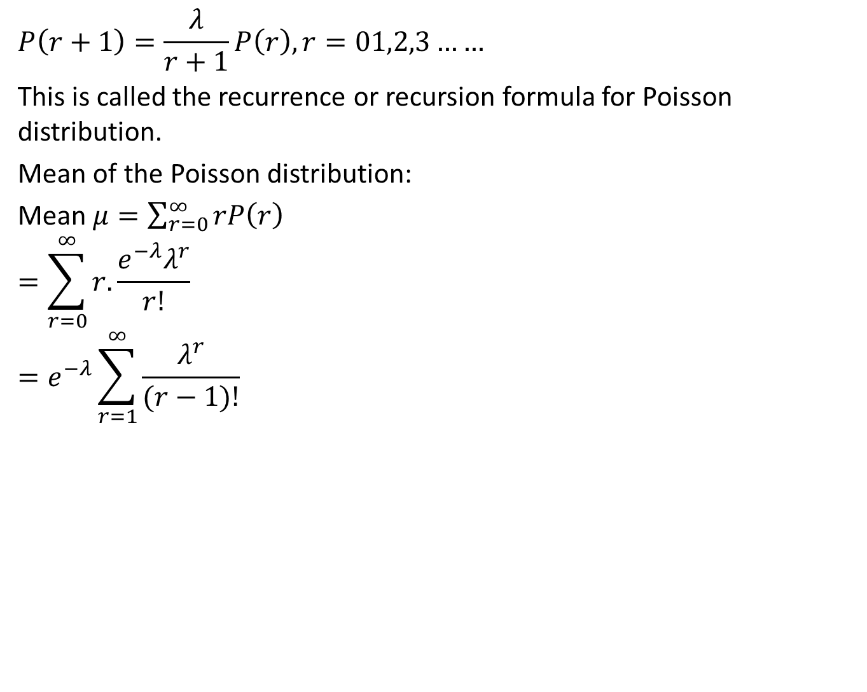
Cont…(CO-3)
$$P\left(r+1\right)=\frac{λ}{r+1}P\left(r\right), r=01,2,3……$$
This is called the recurrence or recursion formula for Poisson distribution.
Mean of the Poisson distribution:
Mean $μ=\sum_{r=0}^{∞}{rP\left(r\right)}$
$$=\sum_{r=0}^{∞}{r.\frac{e^{−λ}λ^{r}}{r!}}$$
$$=e^{−λ}\sum_{r=1}^{∞}{\frac{λ^{r}}{(r−1)!}}$$
AIML Unit-3

Slide 25
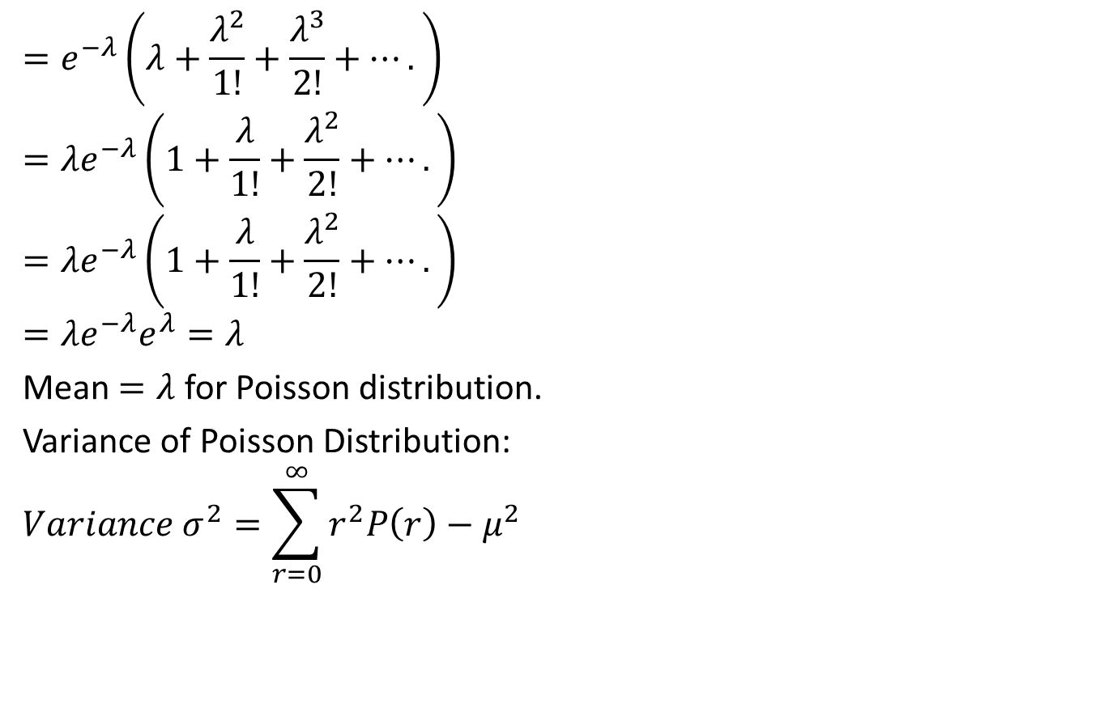
Cont…(CO-3)
$$=e^{−λ}\left(λ+\frac{λ^{2}}{1!}+\frac{λ^{3}}{2!}+….\right)$$
$$={λe}^{−λ}\left(1+\frac{λ}{1!}+\frac{λ^{2}}{2!}+….\right)$$
$$={λe}^{−λ}\left(1+\frac{λ}{1!}+\frac{λ^{2}}{2!}+….\right)$$
$$={λe}^{−λ}e^{λ}=λ$$
Mean $=λ$ for Poisson distribution.
Variance of Poisson Distribution:
$$Variance σ^{2}=\sum_{r=0}^{∞}{r^{2}P\left(r\right)−μ^{2}}$$
AIML Unit-3

Slide 26
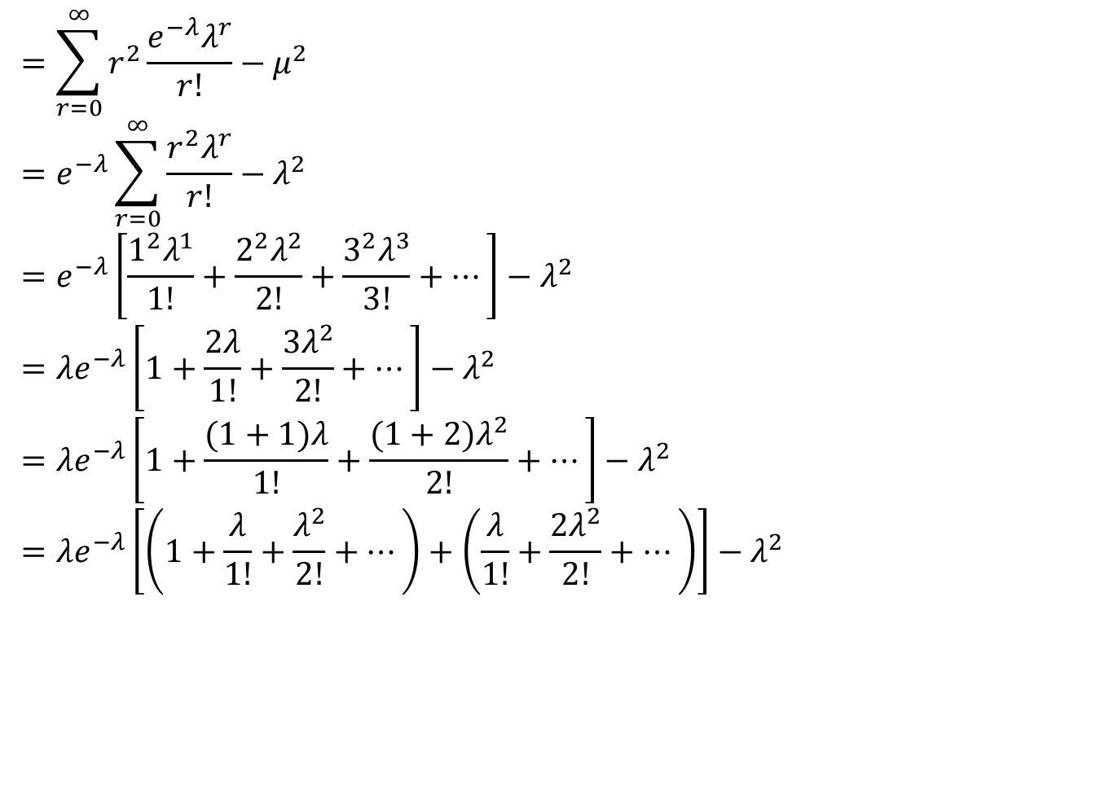
Cont…(CO-3)
$$=\sum_{r=0}^{∞}{r^{2}\frac{e^{−λ}λ^{r}}{r!}−μ^{2}}$$
$$=e^{−λ}\sum_{r=0}^{∞}{\frac{r^{2}λ^{r}}{r!}−λ^{2}}$$
$$=e^{−λ}\left[\frac{1^{2}λ^{1}}{1!}+\frac{2^{2}λ^{2}}{2!}+\frac{3^{2}λ^{3}}{3!}+…\right]−λ^{2}$$
$$={λe}^{−λ}\left[1+\frac{2λ}{1!}+\frac{3λ^{2}}{2!}+…\right]−λ^{2}$$
$$={λe}^{−λ}\left[1+\frac{(1+1)λ}{1!}+\frac{(1+2)λ^{2}}{2!}+…\right]−λ^{2}$$
$$={λe}^{−λ}\left[\left(1+\frac{λ}{1!}+\frac{λ^{2}}{2!}+…\right)+\left(\frac{λ}{1!}+\frac{{2λ}^{2}}{2!}+…\right)\right]−λ^{2}$$
AIML Unit-3

Slide 27
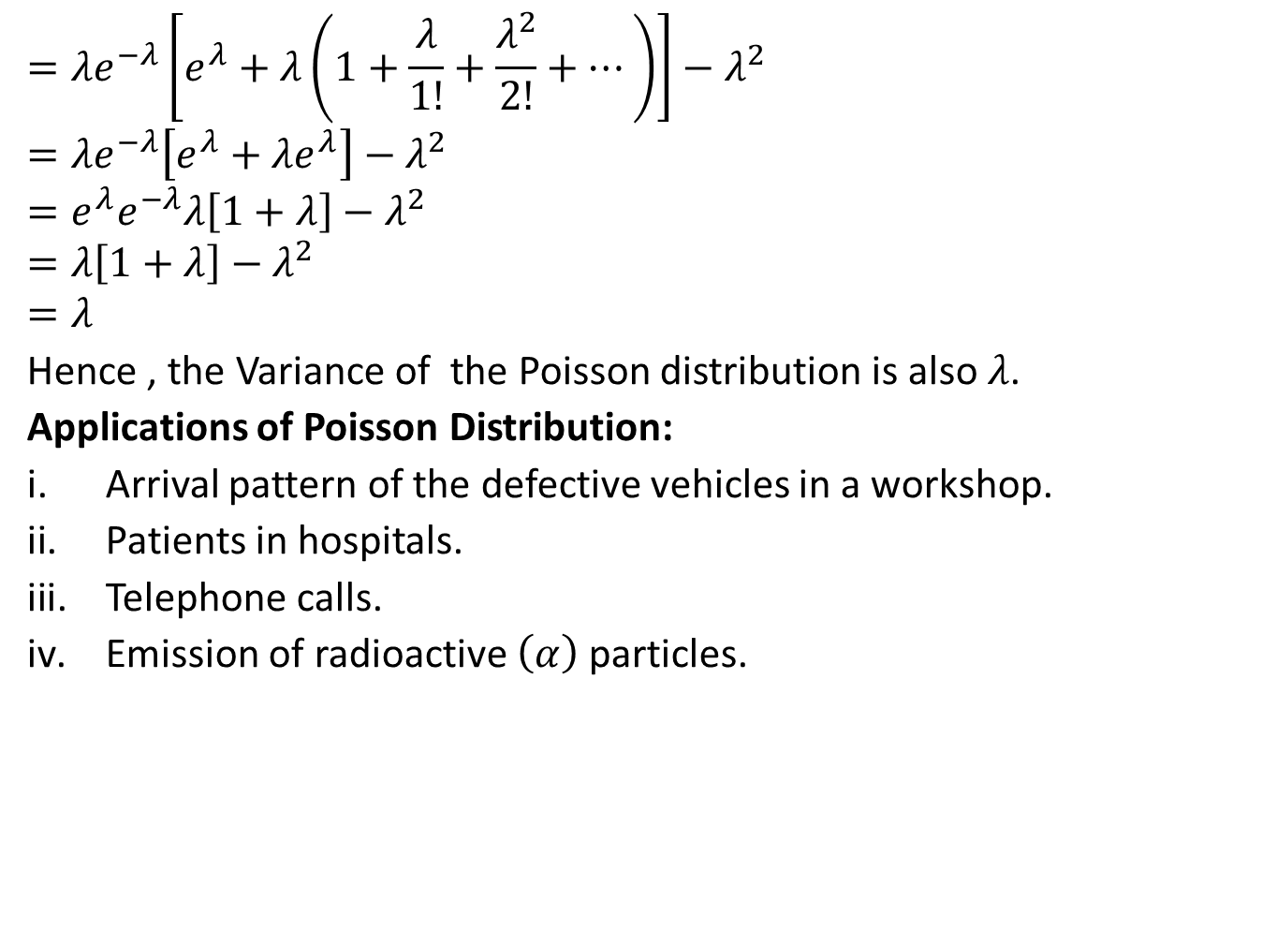
Cont…(CO-3)
$$={λe}^{−λ}\left[e^{λ}+λ\left(1+\frac{λ}{1!}+\frac{λ^{2}}{2!}+…\right)\right]−λ^{2}$$
$$={λe}^{−λ}\left[e^{λ}+λe^{λ}\right]−λ^{2}$$
$$=e^{λ}e^{−λ}λ\left[1+λ\right]−λ^{2}$$
$$=λ\left[1+λ\right]−λ^{2}$$
$$=λ$$
Hence , the Variance of the Poisson distribution is also $λ$.
Applications of Poisson Distribution:
Arrival pattern of the defective vehicles in a workshop.
Patients in hospitals.
Telephone calls.
Emission of radioactive $\left(α\right)$ particles.
AIML Unit-3

Slide 28
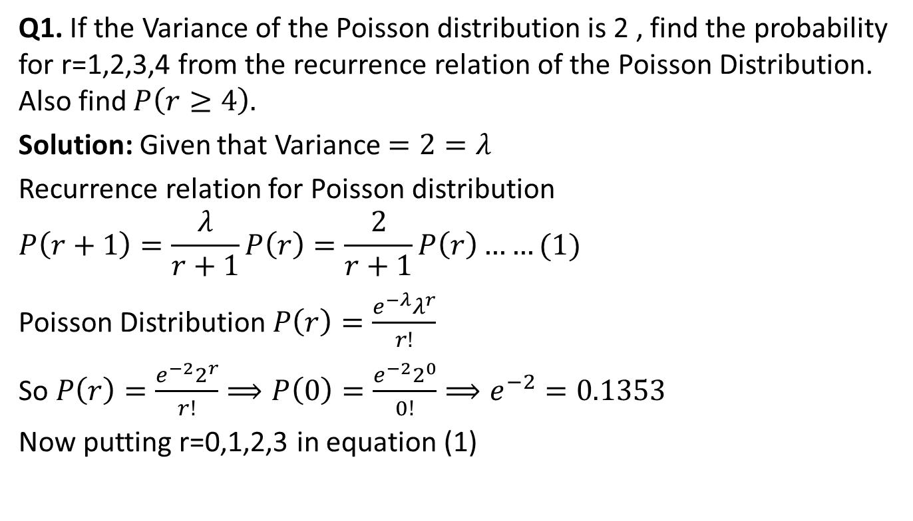
Problem based on Poisson
Distributions(CO-3)
Q1. If the Variance of the Poisson distribution is 2 , find the probability for r=1,2,3,4 from the recurrence relation of the Poisson Distribution. Also find $P\left(r≥4\right).$
Solution: Given that Variance $=2=λ$
Recurrence relation for Poisson distribution
$$P\left(r+1\right)=\frac{λ}{r+1}P\left(r\right)=\frac{2}{r+1}P\left(r\right)……(1)$$
Poisson Distribution $P\left(r\right)=\frac{e^{−λ}λ^{r}}{r!}$
So $P\left(r\right)=\frac{e^{−2}2^{r}}{r!}⟹P\left(0\right)=\frac{e^{−2}2^{0}}{0!}⟹e^{−2}=0.1353$
Now putting r=0,1,2,3 in equation (1)
AIML Unit-3

Slide 29
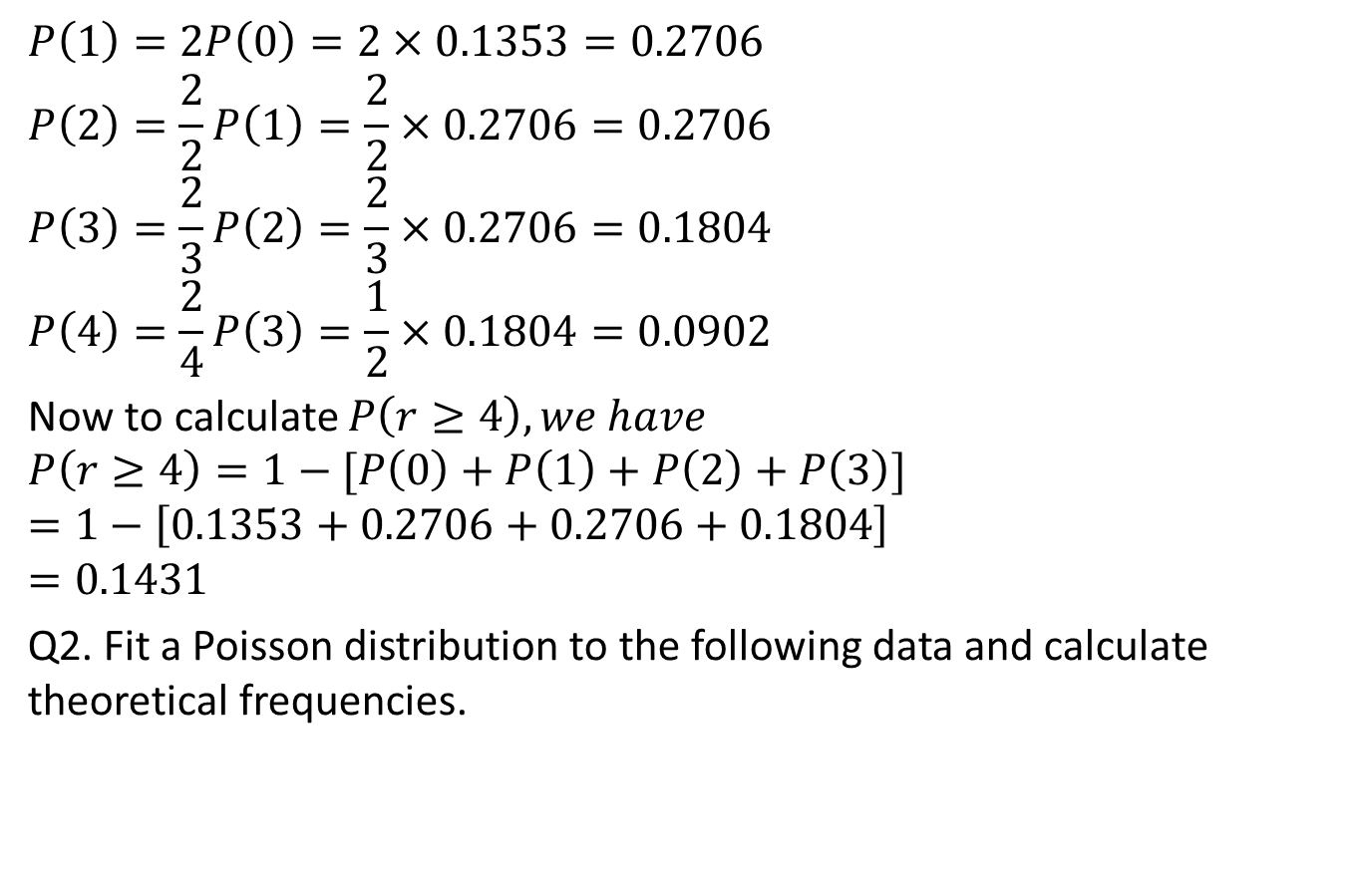
Cont…(CO-3)
$$P\left(1\right)=2P\left(0\right)=2×0.1353=0.2706$$
$$P\left(2\right)=\frac{2}{2}P\left(1\right)=\frac{2}{2}×0.2706=0.2706$$
$$P\left(3\right)=\frac{2}{3}P\left(2\right)=\frac{2}{3}×0.2706=0.1804$$
$$P\left(4\right)=\frac{2}{4}P\left(3\right)=\frac{1}{2}×0.1804=0.0902$$
Now to calculate $P\left(r≥4\right), we have$
$$P\left(r≥4\right)=1−[P\left(0\right)+P\left(1\right)+P\left(2\right)+P\left(3\right)]$$
$$=1−\left[0.1353+0.2706+0.2706+0.1804\right]$$
$$=0.1431$$
Q2. Fit a Poisson distribution to the following data and calculate theoretical frequencies.
AIML Unit-3

Slide 30
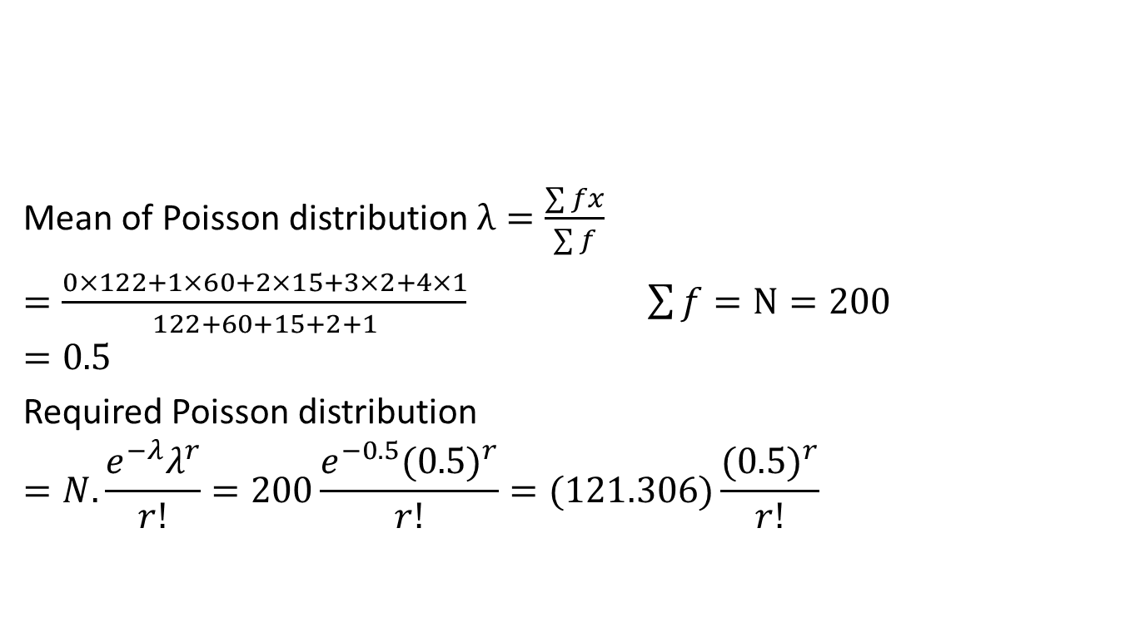
Cont…(CO-3)
Mean of Poisson distribution $λ=\frac{\sum{fx}}{\sum{f}}$
$$=\frac{0×122+1×60+2×15+3×2+4×1}{122+60+15+2+1}\sum{f}=N=200$$
$$=0.5$$
Required Poisson distribution
$$=N.\frac{e^{−λ}λ^{r}}{r!}=200\frac{e^{−0.5}{(0.5)}^{r}}{r!}=(121.306)\frac{({0.5)}^{r}}{r!}$$
Deaths: | 0 | 1 | 2 | 3 | 4
Frequencies | 122 | 60 | 15 | 2 | 1
AIML Unit-3

Slide 31
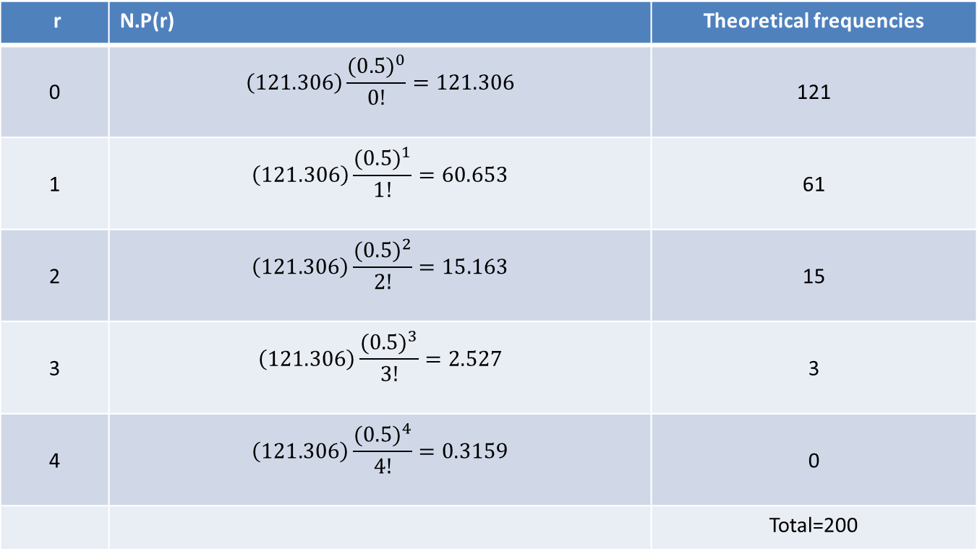
Cont…(CO-3)
r | N.P(r) | Theoretical frequencies
0 | $$\left(121.306\right)\frac{({0.5)}^{0}}{0!}=121.306$$ | 121
1 | $$\left(121.306\right)\frac{({0.5)}^{1}}{1!}=60.653$$ | 61
2 | $$\left(121.306\right)\frac{({0.5)}^{2}}{2!}=15.163$$ | 15
3 | $$\left(121.306\right)\frac{({0.5)}^{3}}{3!}=2.527$$ | 3
4 | $$\left(121.306\right)\frac{({0.5)}^{4}}{4!}=0.3159$$ | 0
 |  | Total=200
AIML Unit-3

Slide 32
Topic objective of Normal Distribution(CO-3)
To define the probability density function of a normal random variable.
To learn the characteristics of a typical normal curve.
To explore the key properties, such as the moment-generating function, mean and variance, of a normal random variable.
AIML Unit-3

Slide 33
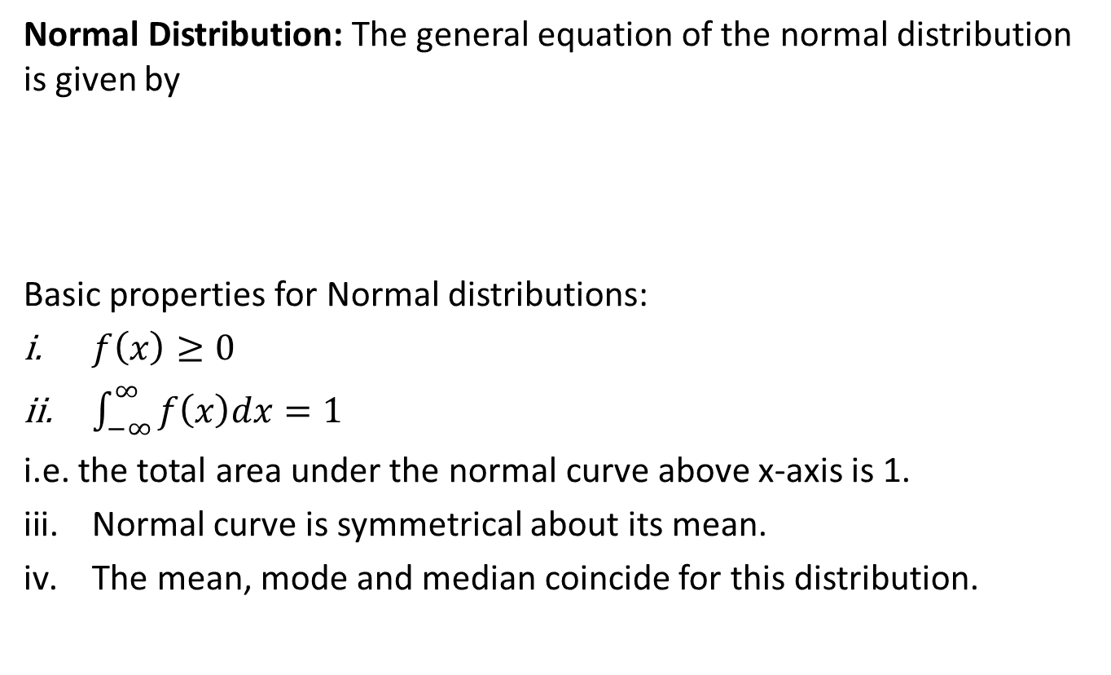

Normal Distribution(CO-3)
Normal Distribution: The general equation of the normal distribution is given by
Basic properties for Normal distributions:
$f\left(x\right)≥0$
$\int_{−∞}^{∞}{f\left(x\right)dx=1}$
i.e. the total area under the normal curve above x-axis is 1.
Normal curve is symmetrical about its mean.
The mean, mode and median coincide for this distribution.
$$f\left(x\right)=\frac{1}{σ\sqrt{2π}}e^{−\frac{1}{2}{\left(\frac{x−μ}{σ}\right)}^{2}}$$
AIML Unit-3

Slide 34
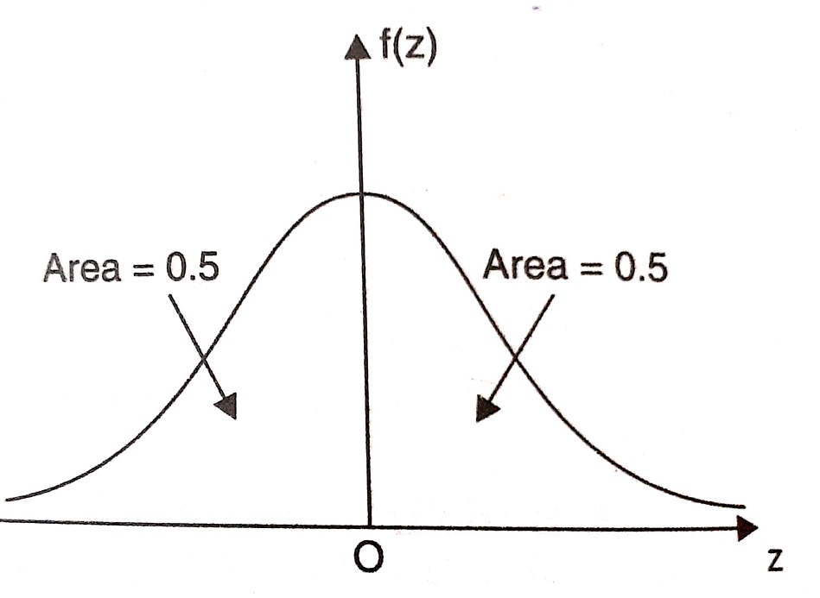
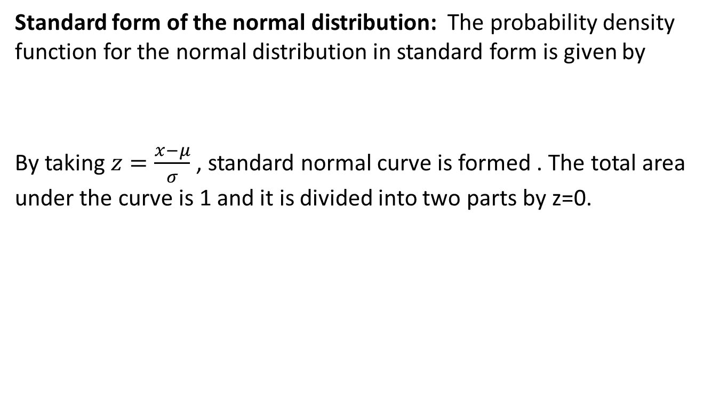

Cont…(CO-3)
Standard form of the normal distribution: The probability density function for the normal distribution in standard form is given by
By taking $z=\frac{x−μ}{σ}$ , standard normal curve is formed . The total area under the curve is 1 and it is divided into two parts by z=0.
$$f\left(z\right)=\frac{1}{\sqrt{2π}}e^{−\frac{1}{2}z^{2}}$$
AIML Unit-3

Slide 35
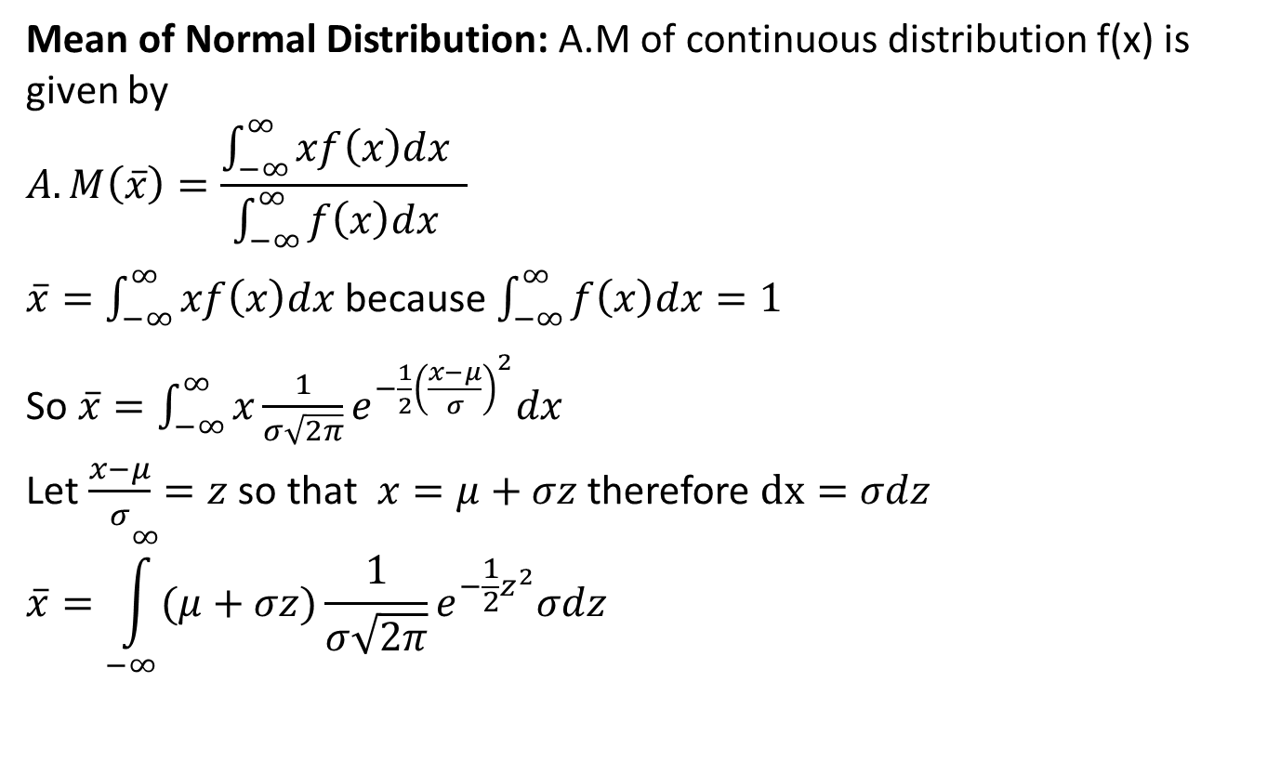
Mean and Variance of Normal
distribution(CO-3)
Mean of Normal Distribution: A.M of continuous distribution f(x) is given by
$$A.M\left(\overline{x}\right)=\frac{\int_{−∞}^{∞}{xf\left(x\right)dx} }{\int_{−∞}^{∞}{f\left(x\right)dx} }$$
$\overline{x}=\int_{−∞}^{∞}{xf\left(x\right)dx}$ because $\int_{−∞}^{∞}{f\left(x\right)dx=1}$
So $\overline{x}=\int_{−∞}^{∞}{x\frac{1}{σ\sqrt{2π}}e^{−\frac{1}{2}{\left(\frac{x−μ}{σ}\right)}^{2}}dx}$
Let $\frac{x−μ}{σ}=z$ so that $x=μ+σz$ therefore $dx=σdz$
$$\overline{x}=\int_{−∞}^{∞}{(μ+σz)\frac{1}{σ\sqrt{2π}}e^{−\frac{1}{2}z^{2}}σdz}$$
KMB-104 Unit-3

Slide 36
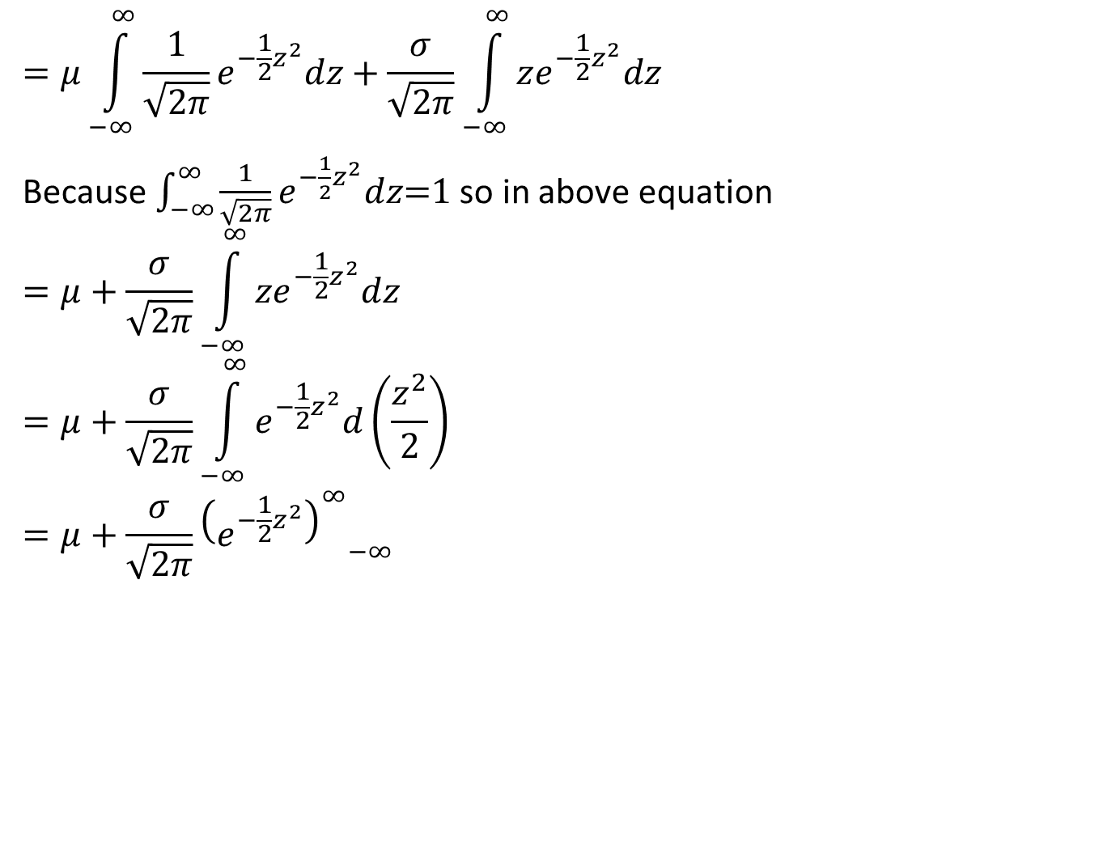
Cont…(CO-3)
$$=μ\int_{−∞}^{∞}{\frac{1}{\sqrt{2π}}e^{−\frac{1}{2}z^{2}}dz+\frac{σ}{\sqrt{2π}}\int_{−∞}^{∞}{ze^{−\frac{1}{2}z^{2}}dz} }$$
Because $\int_{−∞}^{∞}{\frac{1}{\sqrt{2π}}e^{−\frac{1}{2}z^{2}}dz\text{=1} }$so in above equation
$$=μ+\frac{σ}{\sqrt{2π}}\int_{−∞}^{∞}{ze^{−\frac{1}{2}z^{2}}dz}$$
$$=μ+\frac{σ}{\sqrt{2π}}\int_{−∞}^{∞}{e^{−\frac{1}{2}z^{2}}d\left(\frac{z^{2}}{2}\right)}$$
$$=μ+\frac{σ}{\sqrt{2π}}{{\left(e^{−\frac{1}{2}z^{2}}\right)}_{}^{∞}}_{−∞}$$
AIML Unit-3

Slide 37
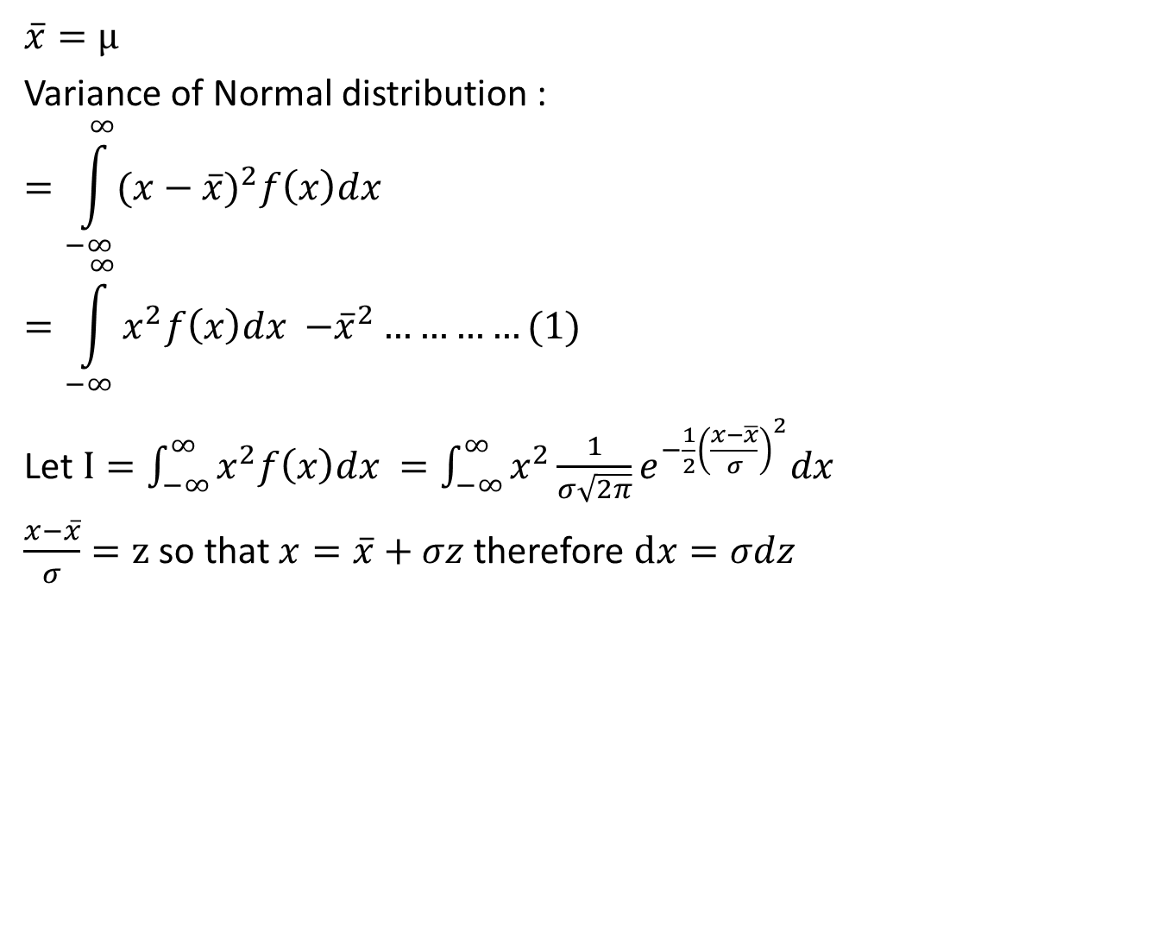
Cont…(CO-3)
$$\overline{x}=μ$$
Variance of Normal distribution :
$$=\int_{−∞}^{∞}{{(x−\overline{x})}^{2}f\left(x\right)dx}$$
$$=\int_{−∞}^{∞}{x^{2}f\left(x\right)dx {−\overline{x}}^{2}}…………(1)$$
Let $I=\int_{−∞}^{∞}{x^{2}f\left(x\right)dx =\int_{−∞}^{∞}{x^{2}}\frac{1}{σ\sqrt{2π}}e^{−\frac{1}{2}{\left(\frac{x−\overline{x}}{σ}\right)}^{2}}dx}$
$\frac{x−\overline{x}}{σ}=z$ so that$x=\overline{x}+σz$therefore $dx=σdz$
AIML Unit-3

Slide 38
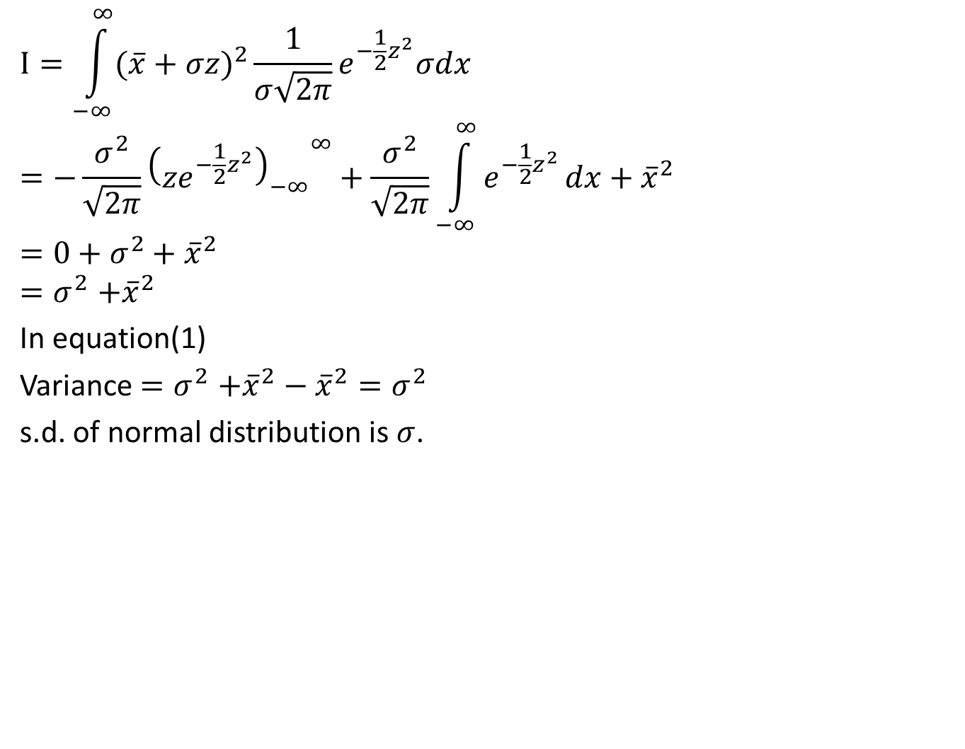
Cont... (CO-3)
$$I=\int_{−∞}^{∞}{{(\overline{x}+σz)}^{2}}\frac{1}{σ\sqrt{2π}}e^{−\frac{1}{2}z^{2}}σdx$$
$$=−\frac{σ^{2}}{\sqrt{2π}}{{\left(ze^{−\frac{1}{2}z^{2}}\right)}_{−∞}}^{∞}+\frac{σ^{2}}{\sqrt{2π}}\int_{−∞}^{∞}{e^{−\frac{1}{2}z^{2}}}dx+{\overline{x}}^{2}$$
$$=0+σ^{2}+{\overline{x}}^{2}$$
$${=σ}^{2}+{\overline{x}}^{2}$$
In equation(1)
Variance ${=σ}^{2}+{\overline{x}}^{2}−{\overline{x}}^{2}=σ^{2}$
s.d. of normal distribution is $σ$.
AIML Unit-3

Slide 39
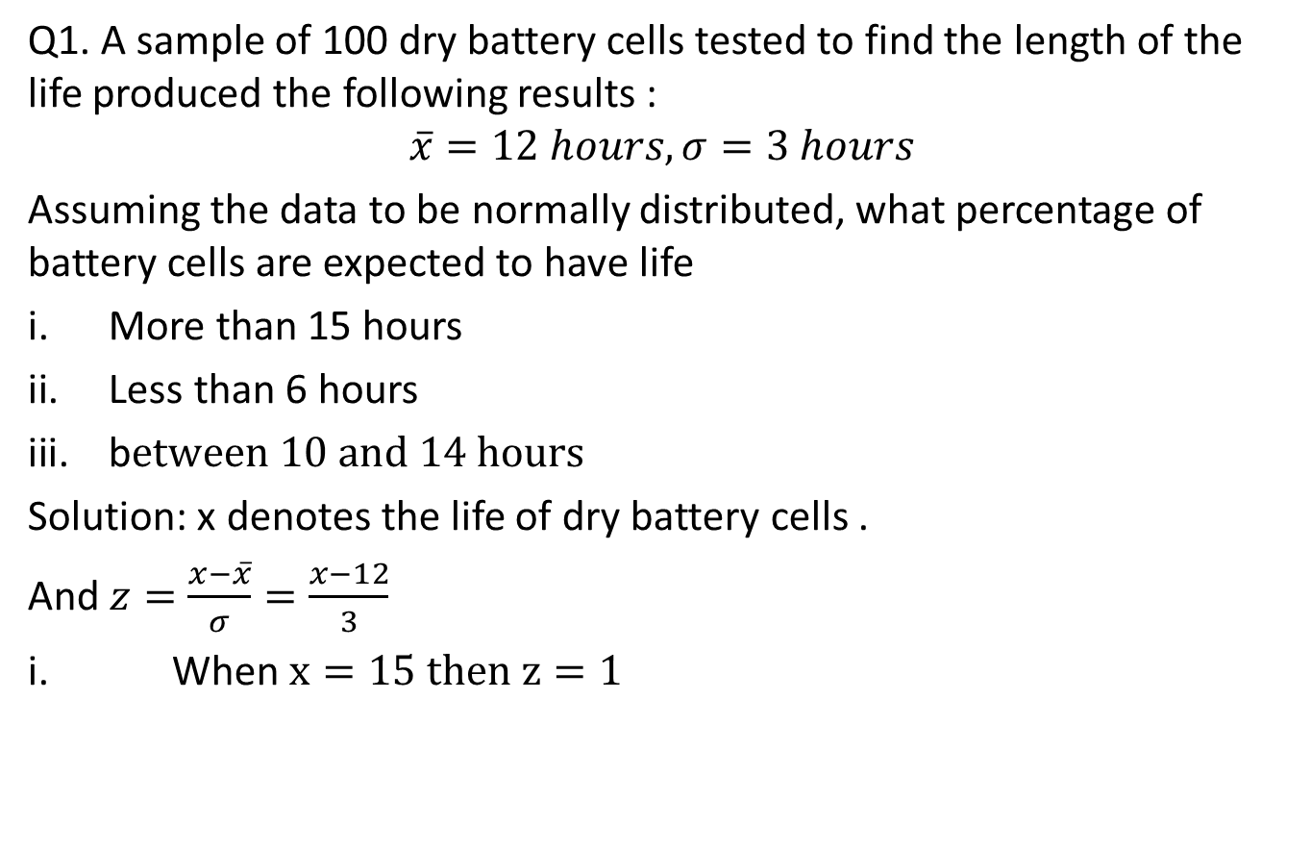
Problem based on Normal
distribution(CO-3)
Q1. A sample of 100 dry battery cells tested to find the length of the life produced the following results :
$$\overline{x}=12 hours, σ=3 hours$$
Assuming the data to be normally distributed, what percentage of battery cells are expected to have life
More than 15 hours
Less than 6 hours
b$etween 10 and 14 hours$
Solution: x denotes the life of dry battery cells .
And $z=\frac{x−\overline{x}}{σ}=\frac{x−12}{3}$
i. When $x=15 then z=1$
AIML Unit-3

Slide 40
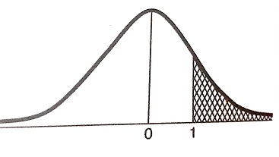
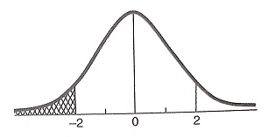
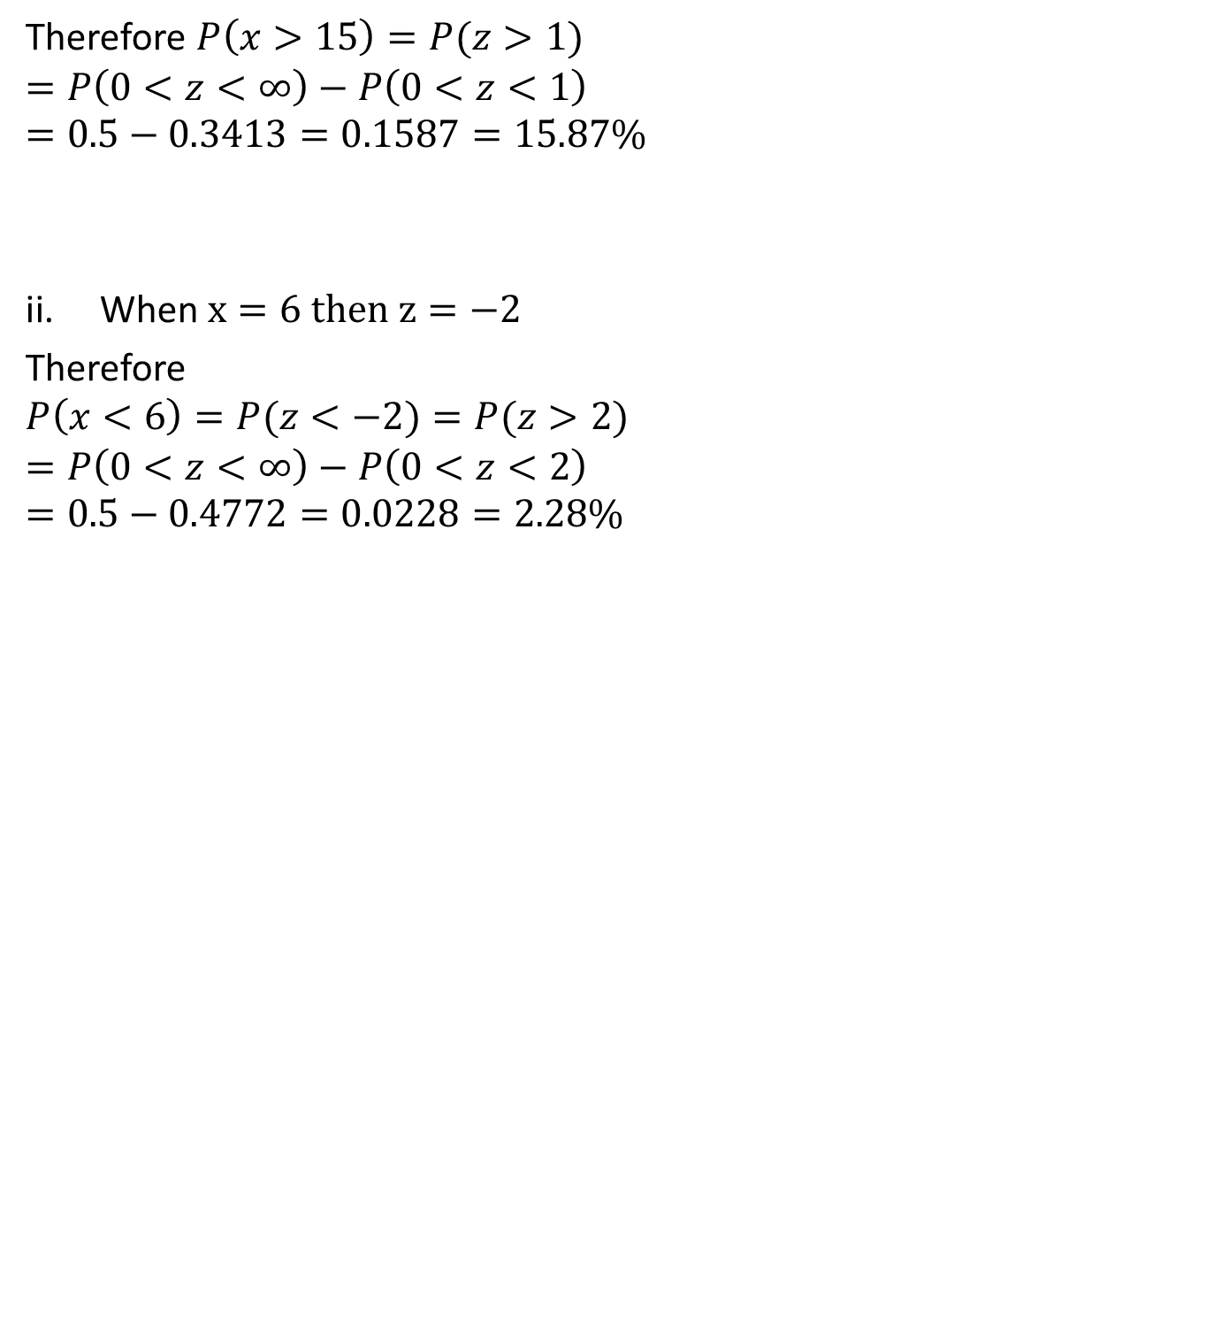
Cont…(CO-3)
Therefore $P\left(x>15\right)=P(z>1)$
$$=P\left(0<z<∞\right)−P\left(0<z<1\right)$$
$$=0.5−0.3413=0.1587=15.87\%$$
When $x=6 then z=−2$
Therefore
$$P\left(x<6\right)=P(z<−2)=P(z>2)$$
$$=P\left(0<z<∞\right)−P\left(0<z<2\right)$$
$$=0.5−0.4772=0.0228=2.28\%$$
AIML Unit-3

Slide 41
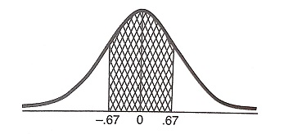

Cont…(CO-3)
When $x=10 then z=−0.67$
$$when x=14 then z=0.67$$
$$P\left(10<x<14\right)=P\left(−0.67<z<\right).67)$$
$$=2P\left(0<z<0.67\right)=2×0.2485=49.70\%$$
AIML Unit-3

Slide 42
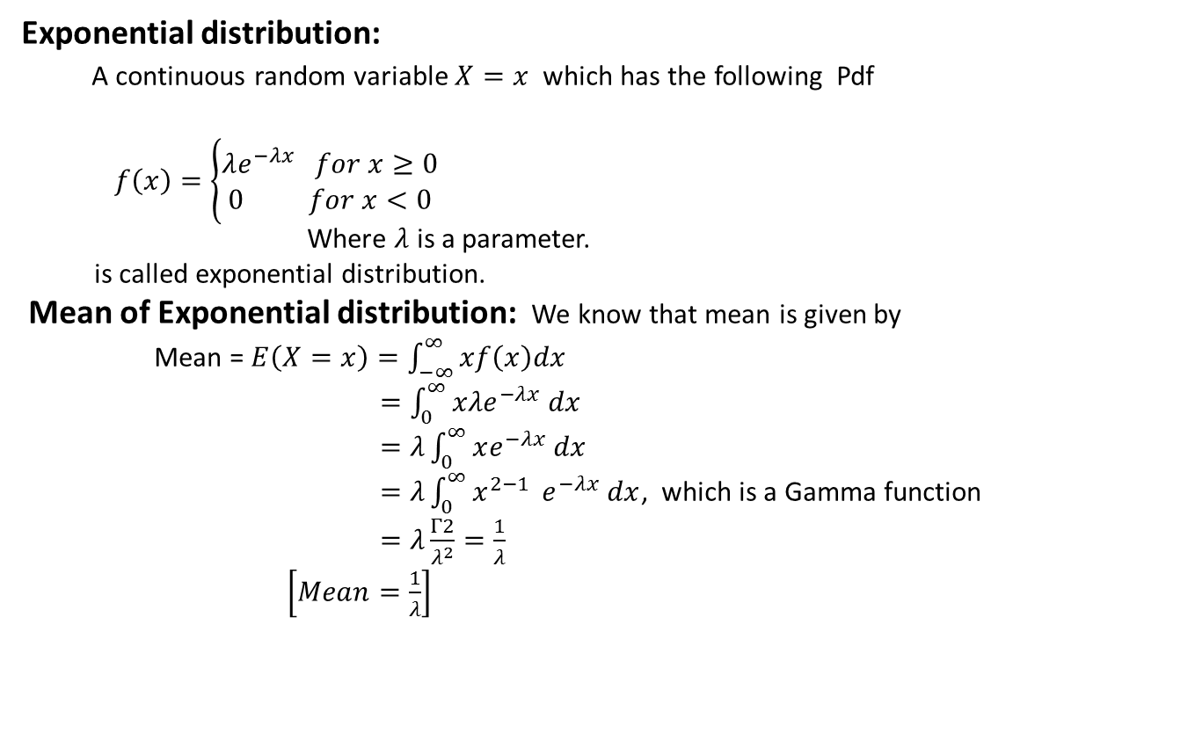
Exponential Distribution(CO-3)
Exponential distribution:
A continuous random variable $X=x$ which has the following Pdf
$f\left(x\right)=\left\{\begin{aligned}λe^{−λx} for x≥0 \\ 0 for x<0\end{aligned}\right.$
Where $λ$ is a parameter.
is called exponential distribution.
Mean of Exponential distribution: We know that mean is given by
Mean = $E\left(X=x\right)=\int_{−∞}^{∞}{xf\left(x\right)dx}$
$=\int_{0}^{∞}{xλe^{−λx} dx}$
$=λ\int_{0}^{∞}{xe^{−λx} dx}$
$=λ\int_{0}^{∞}{x^{2−1}} e^{−λx} dx$, which is a Gamma function
$=λ\frac{Γ2}{λ^{2}}=\frac{1}{λ}$
$\left[Mean=\frac{1}{λ}\right]$
AIML Unit-3

Slide 43
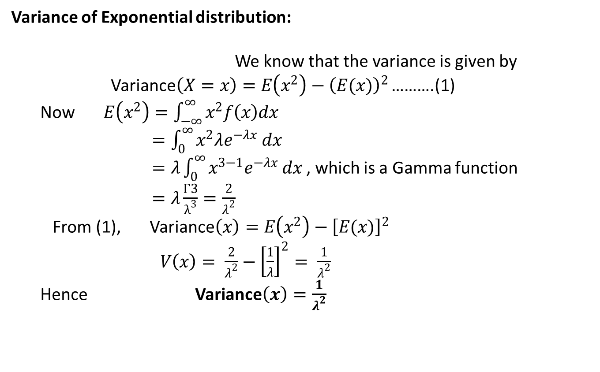
Exponential Distribution(CO-3)
Variance of Exponential distribution:
We know that the variance is given by
Variance$\left(X=x\right)=E\left(x^{2}\right)−{\left(E(x)\right)}^{2}$ ……….(1)
Now $E\left(x^{2}\right)=\int_{−∞}^{∞}{x^{2}f\left(x\right)dx}$
$=\int_{0}^{∞}{x^{2}λe^{−λx} dx}$
$=λ\int_{0}^{∞}{x^{3−1}e^{−λx} dx }$, which is a Gamma function
$=λ\frac{Γ3}{λ^{3}}=\frac{2}{λ^{2}}$
From (1), Variance$\left(x\right)=E\left(x^{2}\right)−{\left[E(x)\right]}^{2}$
$V\left(x\right)= \frac{2}{λ^{2}}−{\left[\frac{1}{λ}\right]}^{2}= \frac{1}{λ^{2}}$
Hence Variance$\left(x\right)=\frac{1}{λ^{2}}$
AIML Unit-3

Slide 44
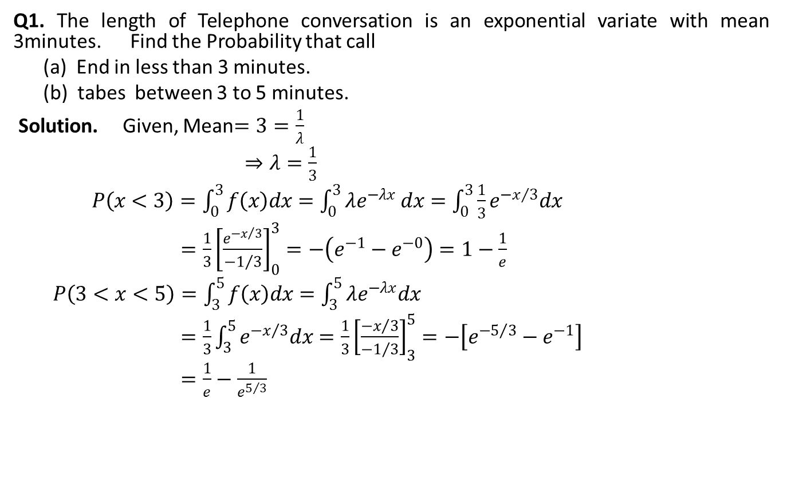
Exponential Distribution(CO-3)
Q1. The length of Telephone conversation is an exponential variate with mean 3minutes. Find the Probability that call
(a) End in less than 3 minutes.
(b) tabes between 3 to 5 minutes.
Solution. Given, Mean$=3=\frac{1}{λ}$
$⇒λ=\frac{1}{3}$
$P\left(x<3\right)=\int_{0}^{3}{f\left(x\right)dx}=\int_{0}^{3}{λe^{−λx} dx}=\int_{0}^{3}{\frac{1}{3}e^{−x/3}dx}$
$=\frac{1}{3}{\left[\frac{e^{{−x}/3}}{{−1}/3}\right]}_{0}^{3}=−\left(e^{−1}−e^{−0}\right)=1−\frac{1}{e}$
$P\left(3<x<5\right)=\int_{3}^{5}{f\left(x\right)dx=\int_{3}^{5}{λe^{−λx}dx}}$
$=\frac{1}{3}\int_{3}^{5}{e^{−x/3}dx}=\frac{1}{3}{\left[\frac{{−x}/3}{{−1}/3}\right]}_{3}^{5}=−\left[e^{−5/3}−e^{−1}\right]$
$=\frac{1}{e}−\frac{1}{e^{5/3}}$
AIML Unit-3

Slide 45
Faculty Video Links, Youtube & NPTEL Video Links and Online Courses Details
Video Link:
Binomial distribution https://youtu.be/6pZXCcoeYiU
Poisson Distribution https://youtu.be/izT2QpldbnU
Normal distribution https://youtu.be/UaLNsZQK8fo
Suggested Video inks:
Bay’s theorem
https://www.youtube.com/watch?v=GSEu5hn2q98
Conditional probability
https://youtu.be/hxn_QwwWZBQ
AIML Unit-3

Slide 46
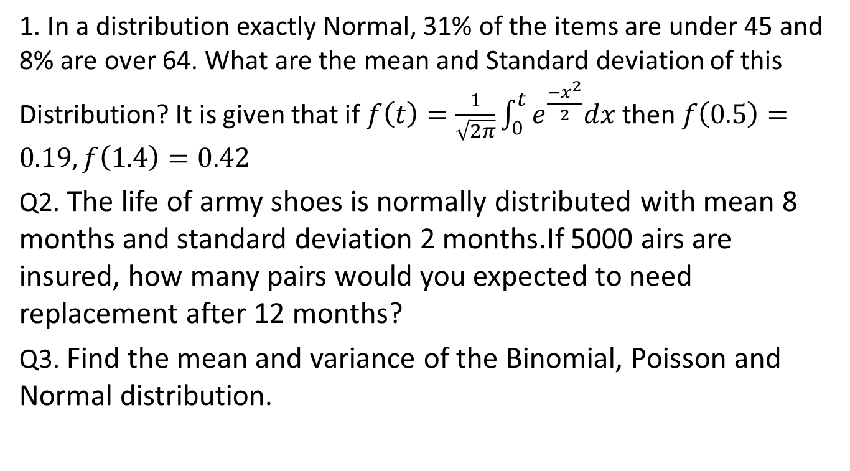
Daily Quiz(CO-3)
1. In a distribution exactly Normal, 31% of the items are under 45 and 8% are over 64. What are the mean and Standard deviation of this Distribution? It is given that if $f\left(t\right)=\frac{1}{\sqrt{2π}}\int_{0}^{t}{e^{\frac{{−x}^{2}}{2}}dx}$then $f\left(0.5\right)=0.19, f\left(1.4\right)=0.42$
Q2. The life of army shoes is normally distributed with mean 8 months and standard deviation 2 months.If 5000 airs are insured, how many pairs would you expected to need replacement after 12 months?
Q3. Find the mean and variance of the Binomial, Poisson and Normal distribution.
AIML Unit-3

Slide 47
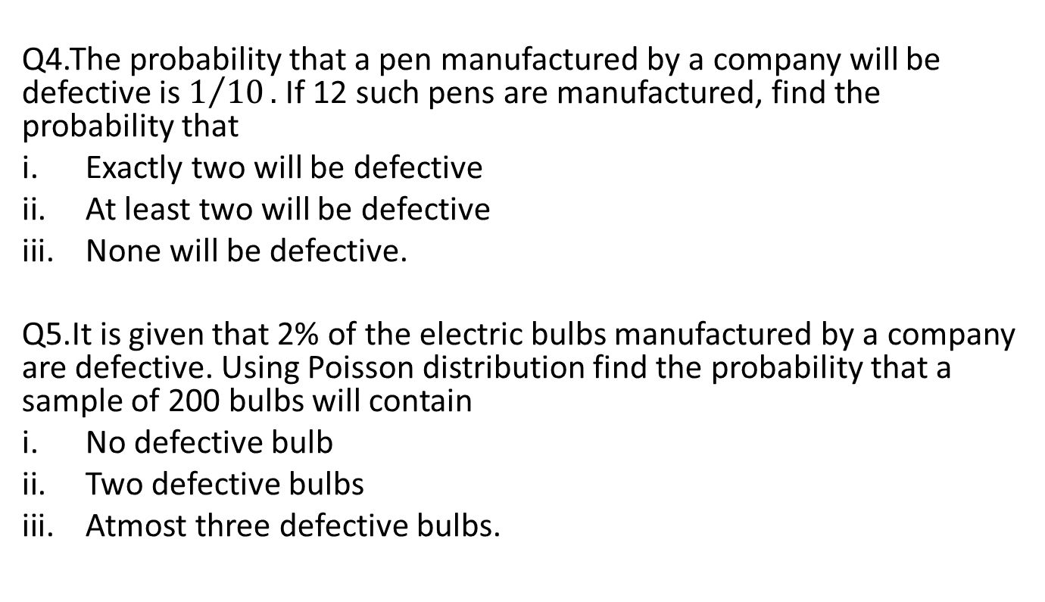
Daily Quiz(CO-3)
Q4.The probability that a pen manufactured by a company will be defective is $1/{10}.$ If 12 such pens are manufactured, find the probability that
Exactly two will be defective
At least two will be defective
None will be defective.
Q5.It is given that 2% of the electric bulbs manufactured by a company are defective. Using Poisson distribution find the probability that a sample of 200 bulbs will contain
No defective bulb
Two defective bulbs
Atmostthree defective bulbs.
AIML Unit-3

Slide 48
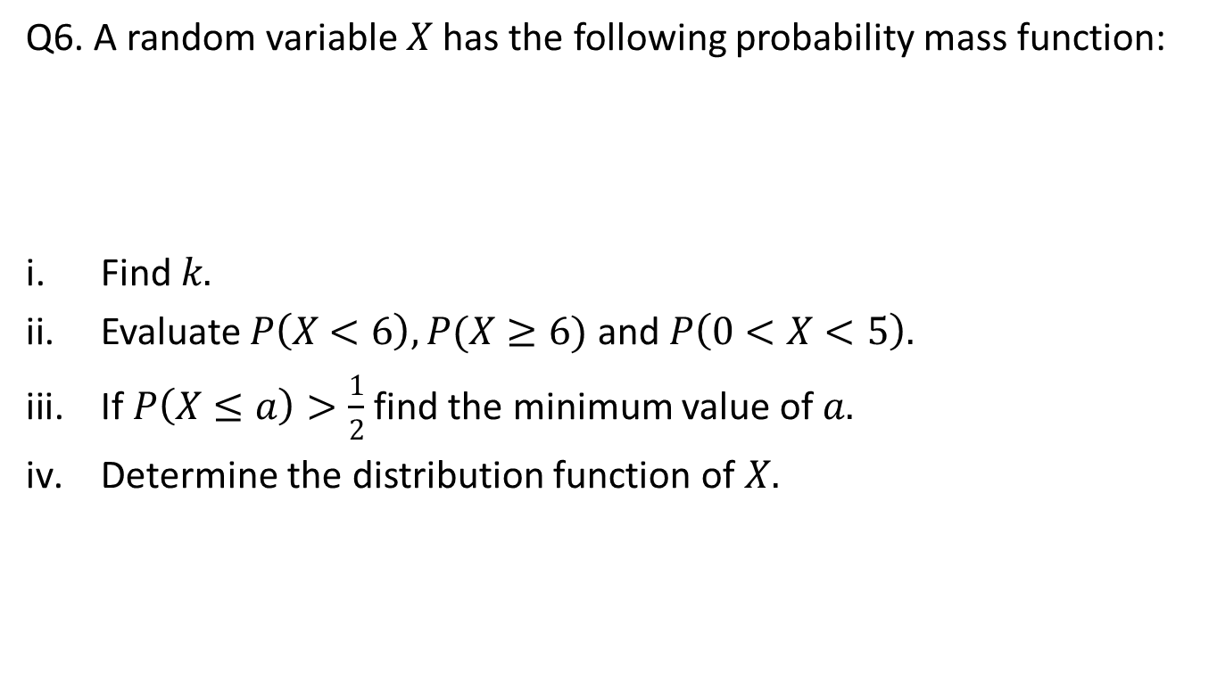
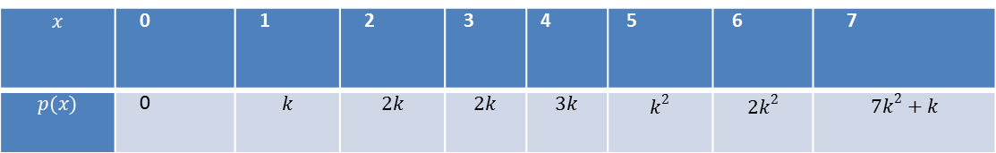
Daily Quiz(CO-3)
Q6. A random variable $X$ has the following probability mass function:
Find $k.$
Evaluate $P\left(X<6\right),P(X≥6)$ and $P\left(0<X<5\right).$
If $P\left(X≤a\right)>\frac{1}{2}$ find the minimum value of $a.$
Determine the distribution function of $X.$
$$x$$ | 0 | 1 | 2 | 3 | 4 | 5 | 6 | 7
$$p(x)$$ | 0 | $$k$$ | $$2k$$ | $$2k$$ | $$3k$$ | $$k^{2}$$ | $${2k}^{2}$$ | $${7k}^{2}+k$$
AIML Unit-3

Slide 49
Daily Quiz(CO-3)
Q7. In a bolt factory machines A,B and C manufacture 25%,35% and 40% of the total. Of their output 5%,4% and 2% are defective bolts. A bolt is drawn at random from the product and is found to be defective. What are the probabilities that it was manufactured by machines A,B or C?
AIML Unit-3

Slide 50
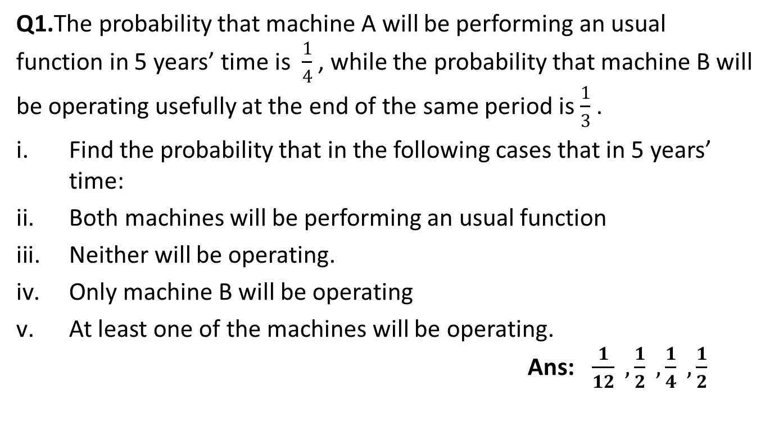
Weekly Assignment(CO-3)
Q1.The probability that machine A will be performing an usual function in 5 years’ time is $\frac{1}{4}$ , while the probability that machine B will be operating usefully at the end of the same period is $\frac{1}{3}$ .
Find the probability that in the following cases that in 5 years’ time:
Both machines will be performing an usual function
Neither will be operating.
Only machine B will be operating
At least one of the machines will be operating.Ans: $\frac{1}{12} ,\frac{1}{2} ,\frac{1}{4} ,\frac{1}{2}$
AIML Unit-3

Slide 51
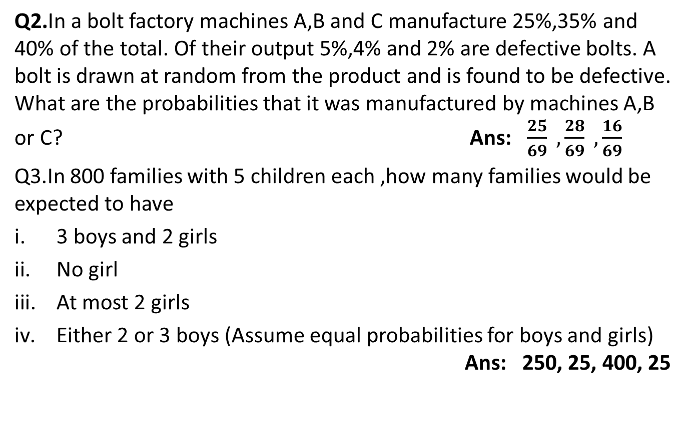
Weekly Assignment(CO-3)
Q2.In a bolt factory machines A,B and C manufacture 25%,35% and 40% of the total. Of their output 5%,4% and 2% are defective bolts. A bolt is drawn at random from the product and is found to be defective. What are the probabilities that it was manufactured by machines A,B or C? Ans: $\frac{25}{69} ,\frac{28}{69} ,\frac{16}{69}$
Q3.In 800 families with 5 children each ,how many families would be expected to have
3 boys and 2 girls
No girl
At most 2 girls
Either 2 or 3 boys (Assume equal probabilities for boys and girls) Ans: 250, 25, 400, 25
AIML Unit-3

Slide 52
Weekly Assignment(CO-3)
Q4.In a test on 2000 electric bulbs,it was found that the life of a particular make, was normally distributed with an average life of 2040 hours and S.D. of 60 hours, estimate the number of bulbs likely to burn for
More than 2150 hours
Less than 1950 hours
More than 1920 hours but less than 2160 hours Ans: 67,134,1909
Q5.In a distribution exactly Normal, 7% of the items are under 35 and 89% are under 63. What are the mean and Standard deviation of this Distribution? Ans: 50.3, 10.33
AIML Unit-3

Slide 53
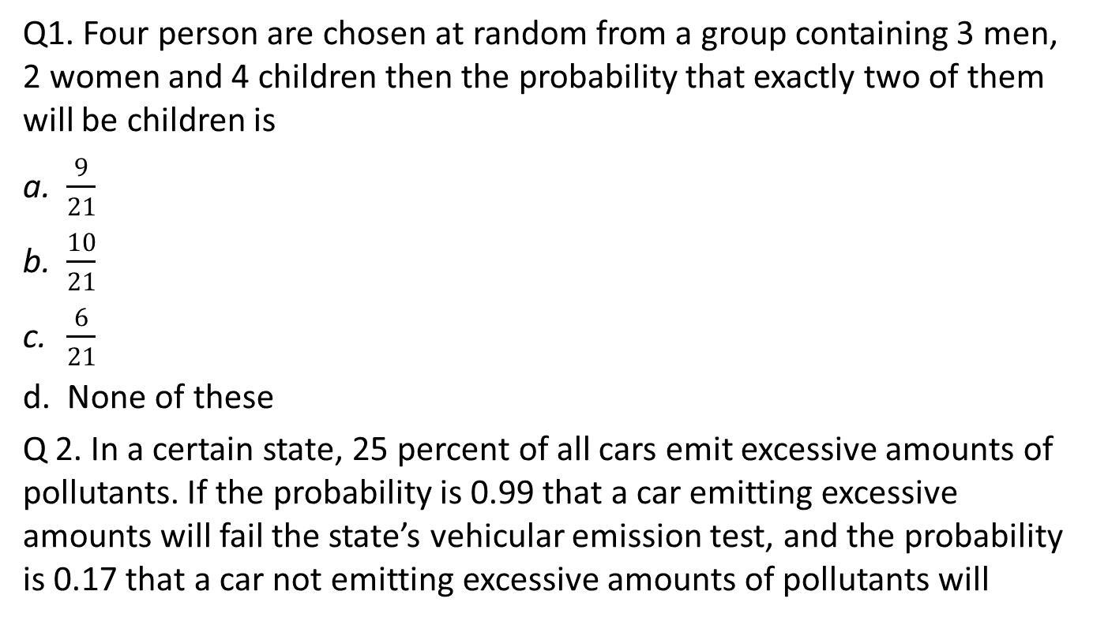
MCQ s(CO-3)
Q1. Four person are chosen at random from a group containing 3 men, 2 women and 4 children then the probability that exactly two of them will be children is
$\frac{9}{21}$
$\frac{10}{21}$
$\frac{6}{21}$
None of these
Q 2. In a certain state, 25 percent of all cars emit excessive amounts of pollutants. If the probability is 0.99 that a car emitting excessive amounts will fail the state’s vehicular emission test, and the probability is 0.17 that a car not emitting excessive amounts of pollutants will
AIML Unit-3

Slide 54
MCQ s(CO-3)
nevertheless fail the test. What is the probability that a car that fails the test actually emits excessive amounts of pollutants?
0.60
0.70
0.66
None of these
Q3. A can hit a target 3 times in 5 shots, B 2 times in 5 shots and C 3 times in 4 shots. All of them fire one shot each simultaneously at the target. What is the probability that at least two shots hit-
0.60
0.62
0.63
0.50
AIML Unit-3

Slide 55
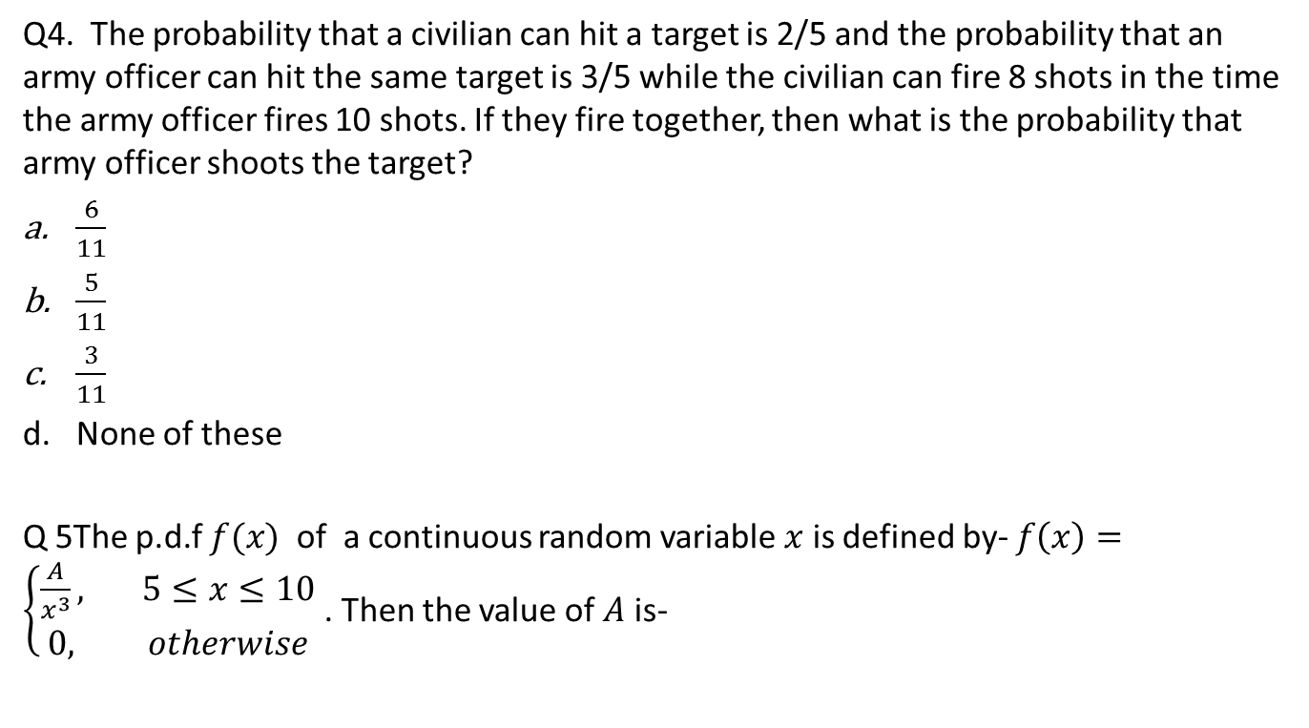
MCQ s(CO-3)
Q4. The probability that a civilian can hit a target is 2/5 and the probability that an army officer can hit the same target is 3/5 while the civilian can fire 8 shots in the time the army officer fires 10 shots. If they fire together, then what is the probability that army officer shoots the target?
$\frac{6}{11}$
$\frac{5}{11}$
$\frac{3}{11}$
None of these
Q 5The p.d.f$f(x)$ of a continuous random variable $x$ is defined by- $f\left(x\right)=\left\{\begin{aligned}\frac{A}{x^{3}}, 5≤x≤10 \\ 0, otherwise\end{aligned}\right.$ . Then the value of $A$ is-
AIML Unit-3

Slide 56

MCQ s(CO-3)
$\frac{100}{3}$
$\frac{200}{3}$
$\frac{50}{3}$
None of these
AIML Unit-3

Slide 57
Old Question Papers(CO-3)
AIML Unit-4

Slide 58
Expected Questions for University
Exam(CO-3)
Q.1A bag contains 5 white and 8 red balls. Two successive drawing of 3 balls are made such that
(i) the balls are replaced before the second trial, and
(ii)the balls are not replaced before the second trial.
Find the probability that the first drawing will give 3 white and the second 3 red balls in each case.
Q.2The experience shows that 4 accidents occur in a plant on an average per month. Calculate the probabilities of less than 3 accidents in a certain month. Use Poisson distribution. (Given e⁻⁴=0.01832).
Q.3As a result of tests on 20,000 electric bulbs manufactured by a company it was found that the life time of a bulb was normally distributed with an average life of 2040 hours and standard deviation of 60 hours. On the basis of the information, estimate the number of bulbs that is expected to burn for
(i) more than 2150 hours, and (ii) less than 1960 hours.
AIML Unit-3

Slide 59
Expected Questions for University
Exam(CO-3)
Q.4 Define Probability? State Addition and Multiplication theorems of probability by giving suitable example.
Q.5 Write short notes on Baye’s Theorem.
Q.6 What are the conditions necessary for a normal distribution to occur? With the help of a suitable diagram, list the chief properties of a normal distribution.
AIML Unit-3

Slide 60
Summary
Students have taught the importance of the following topics….
With the concept of probability to evaluate probability distributions:
Binomial Distribution
Poisson Distribution
Normal Distribution
Exponential Distribution

Slide 61
References
Introduction to Statistics - P.K. Giri & J. Banerjee.
Statistical Models: Theory and Practice by David Freedman.
Richard I. Levin, David S.Rubin “Statistics for Management”, Pearson Education
Anderson, Sweeney and Williams “Statistics for Business and Economics”, Cengage Learning.
Slideshare
AIML Unit-3

